Slide 1
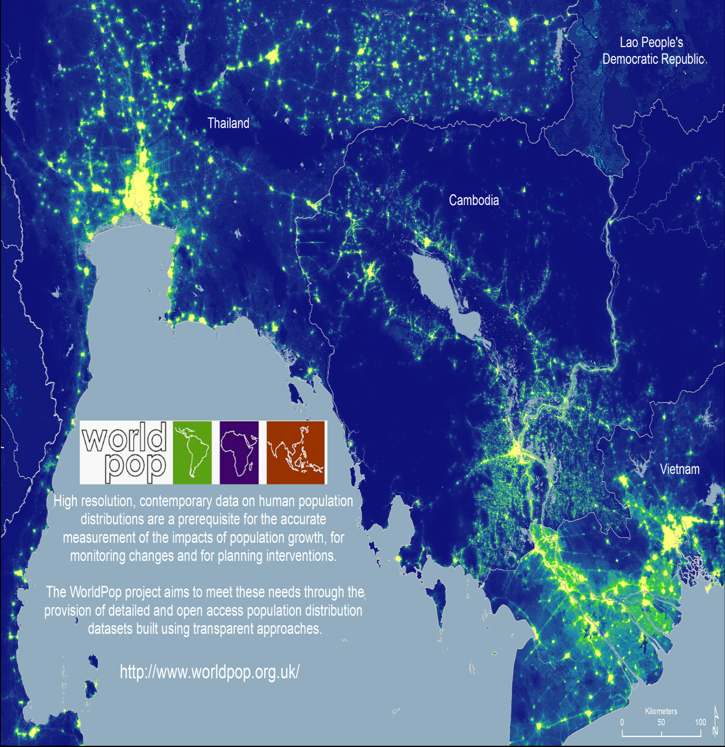
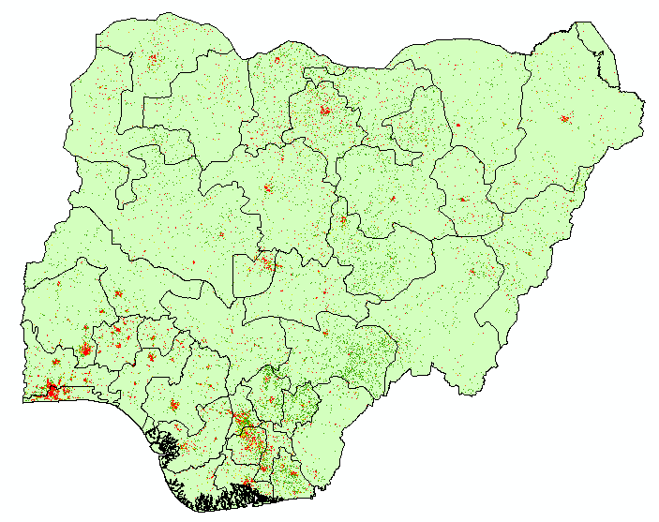


Workshop on Modelled Population Estimates to Support Census Processes in Nigeria
Dr Chibuzor (Chris) Nnanatu
(Team Leader, SSPM)
Notes:
Walk you through a relatively new and rapidly changing research field that has geography at its heart. It’s one that’s focussed on trying to improve the health and wellbeing of people everywhere – reducing inequalities and not leaving people behind.
This presentation provides an overview of geospatial methods, drawing on ‘big data’ and other sources, for complimenting traditional sources of demographic data in building evidence bases for monitoring progress towards the SDGs at subnational scales, and designing strategies. The examples come from work being undertaken by the WorldPop project (www.worldpop.org) and the Flowminder Foundation (www.flowminder.org), which both focus on improving the spatial demographic evidence bases for low and middle income countries, partnering with national statistical agencies, UN organizations, mobile network operators and data providers to add value to traditional datasources and integrate them with novel datasources to fill gaps.

Slide 2

OUTLINE FOR TODAY
10.15 – 10.30 | Break | Presenter
10.30 - 12.00 | Overview of WorldPop top-down and bottom-up population models | WorldPop - Chris
12.00 - 13.00 | Lunch
13.0– 14.30 | Basics of R – Theory/Practical | Ortis
14.30-14.40 | Break
14.40 – 16.00 | Data Manipulation & Visualization in R – Practical | Ortis
16.00 – 16.30 | Group Activities/IT support/Wrap-Up | All

Slide 3

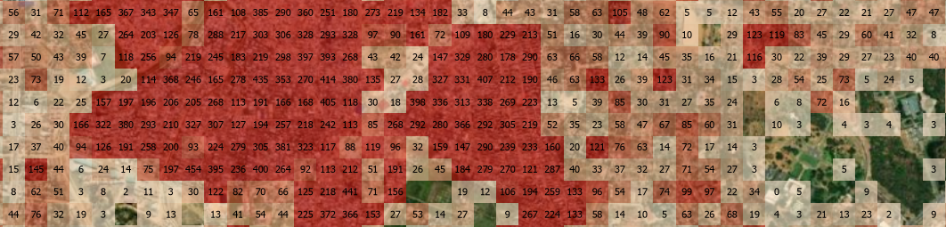

What are the advantages of gridded population data?
Flexibility in terms of spatial aggregation - population estimates can be calculated for different geographic units at a range of scales:
EAs, Wards, Constituencies, Districts
Polling station catchments, Land cover classes, Flooded area, Cyclone track
Within a specified distance of a feature e.g. 5km from a polling station
Integration with other gridded datasets
Administrative units / Health catchments
Settlement extents

Slide 4
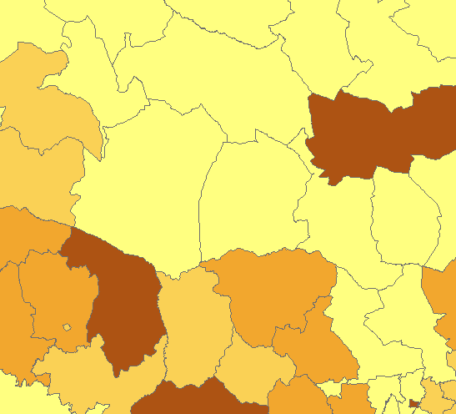
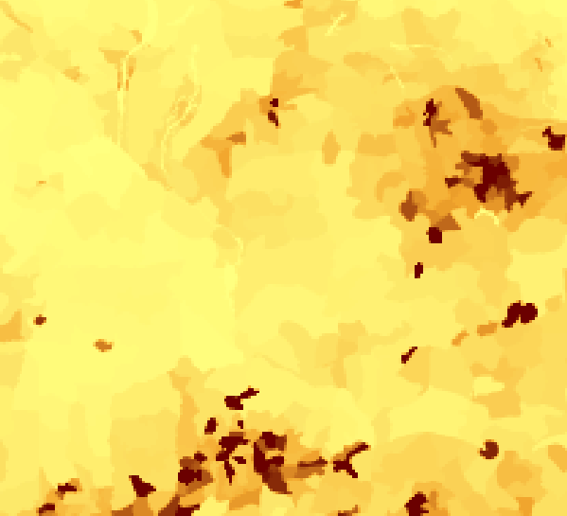
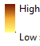
Introduction
We have seen earlier the value of small area gridded population estimates and how they can be used
How can we construct these?
‘Top-down’ modelling is one approach
Here we go from aggregated counts to gridded estimates

Slide 5
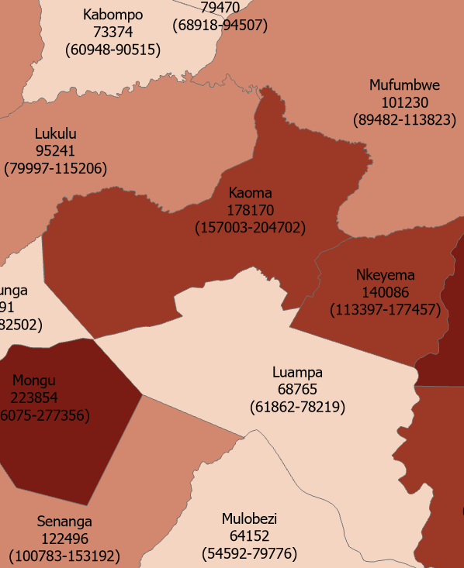
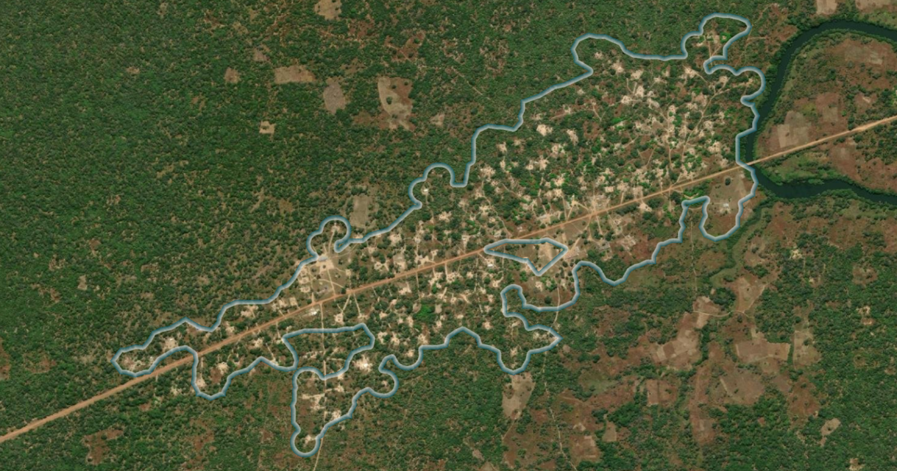
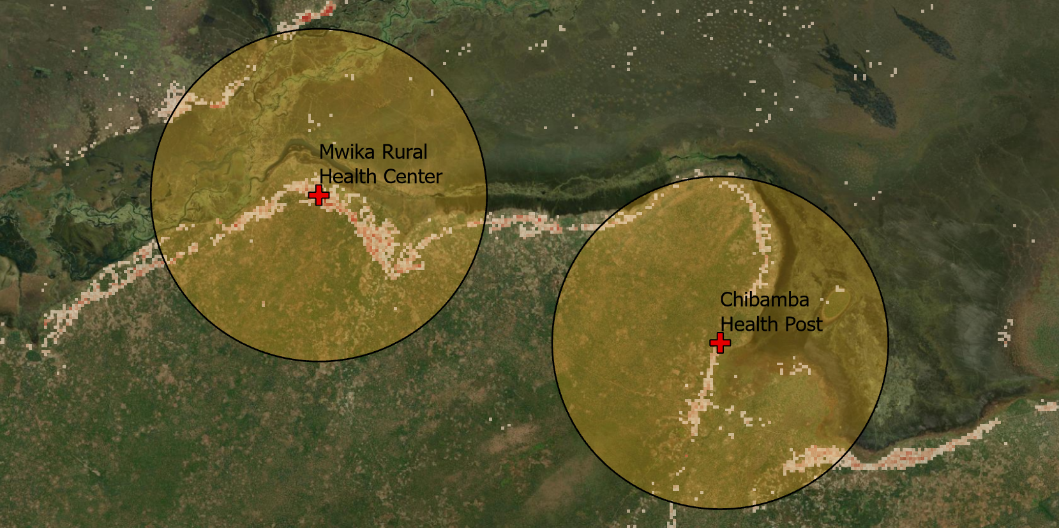
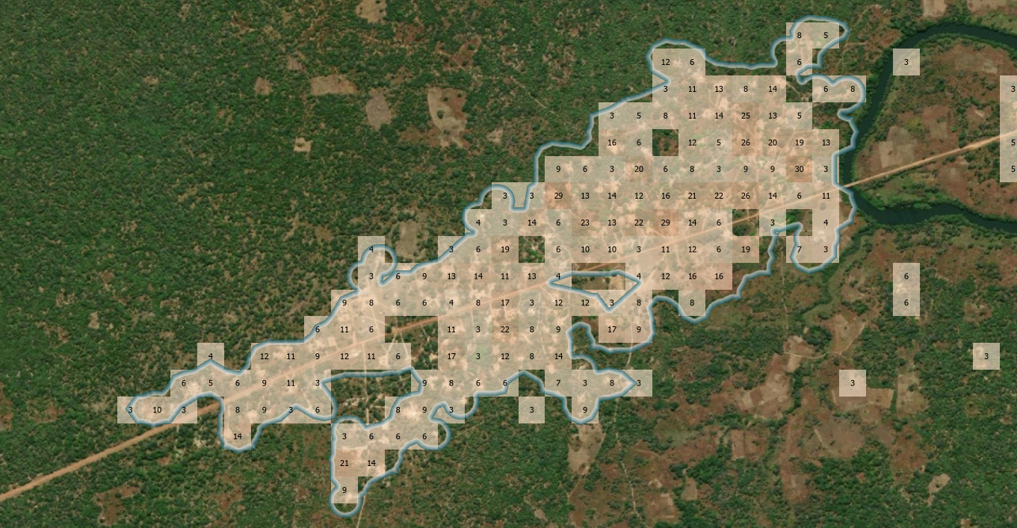
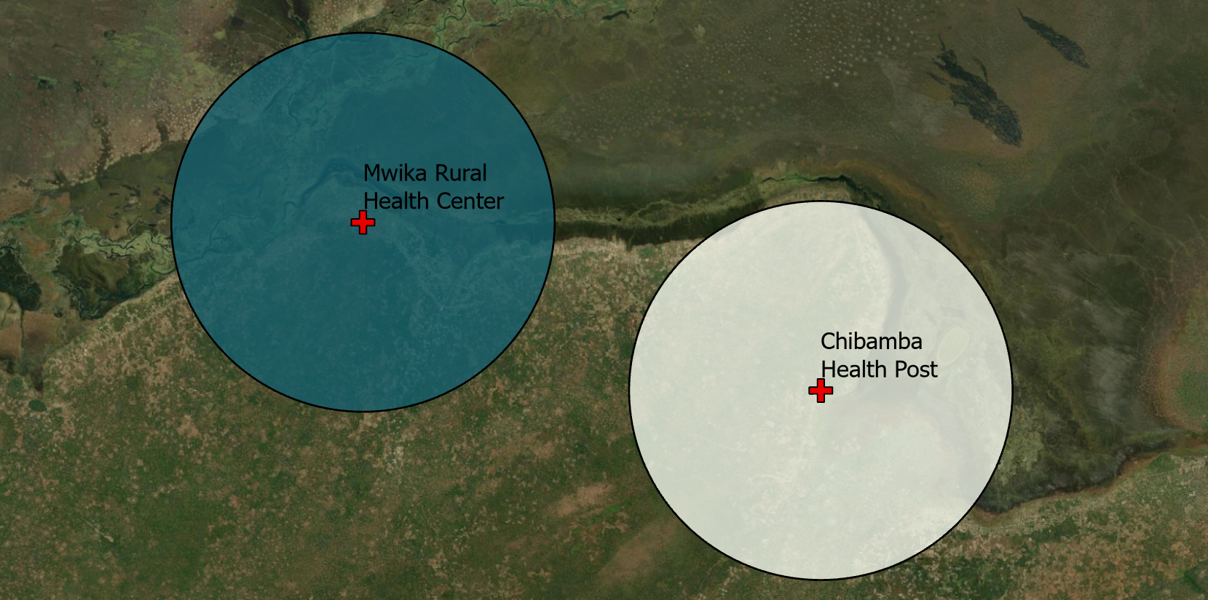
Administrative units / Health units
Settlement extents
Custom e.g. specified proximity/distance
Image 1
Image 2
Image 3
Within 5km distance
Estimated population:
1547
Pop: 2360
Pop: 4862
Flexibility in aggregation of population estimates

Slide 6
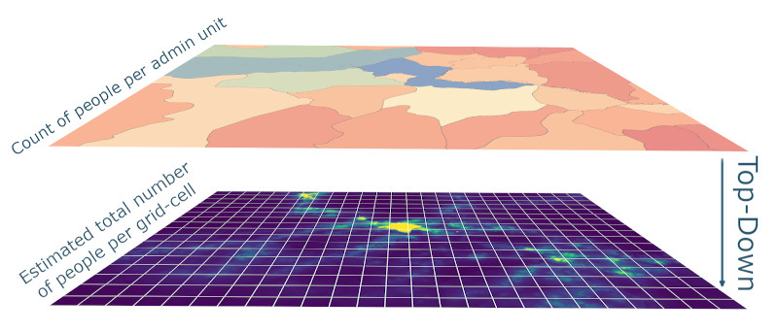
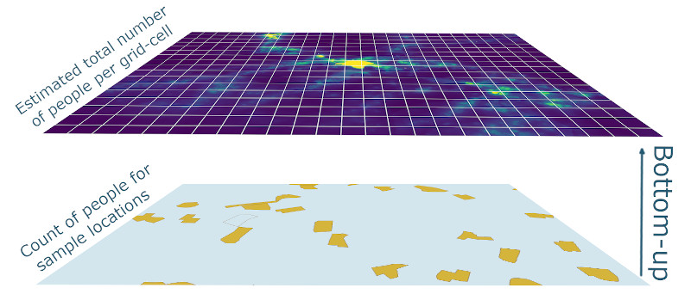
Overview of approaches for creating gridded population datasets
“Top down”
modelling approach
“Bottom-up”
modelling approach
www.worldpop.org/methods/populations

Slide 7
Top-down
Bottom-up
Population totals for enumeration zones with full national coverage.
Population totals for a sample of enumeration zones.
“The last national census was 1984 so don’t trust that data, but I need small area population data and do have some recent sample enumeration data”
“We have conducted our census, but could not access certain areas and need estimates for these”
?
“I trust these subnational province-level projections, but need finer scale estimates”
“I need gridded outputs that match my district unit totals”
?
?
?
?
?
?
?
?
?
National Boundary
Enumeration Zone
More red = more people

Slide 8
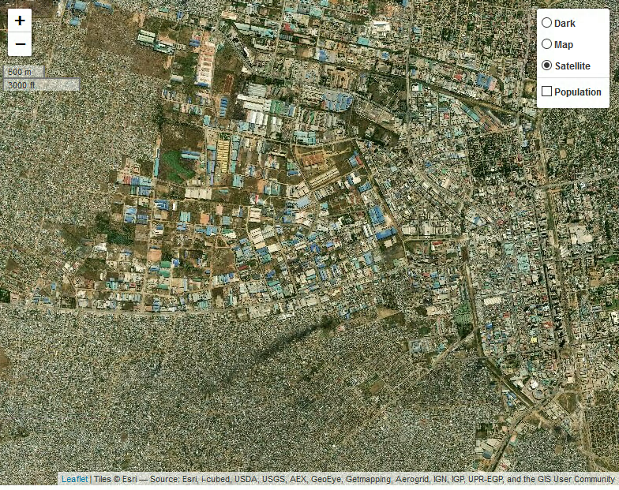
“Bottom-up” modelling approach
www.worldpop.org/methods/populations
Notes:
This is an example of a dataset produced using “bottom-up” population modelling approaches. This approach starts with population counts for geographically well-defined sample locations. In the case of Zambia this data was from a range of household surveys, conducted by ZamStats, which included population enumeration.
Worldpop then developed a statistical model using a range of geospatial covariates - factors which are associated with population density and distribution and which data are available for both survey locations and the rest of the country, enabling prediction of population for all areas of the country at approximately 100m spatial resolution……

Slide 9
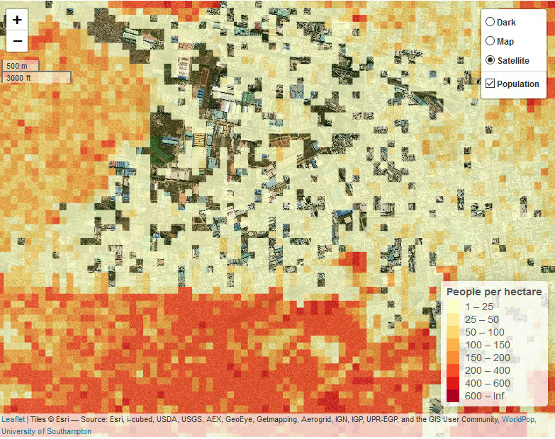
“Bottom-up” modelling approach
www.worldpop.org/methods/populations
Notes:
The bottom-up population modelling approach requires development of a custom model for a particular country. It also requires suitable data on counts of population to be available otherwise a specific data collection survey may be needed. This all means that the bottom-up modelling approach can be quite time and resource-intensive, and has so far only been used in a small number of countries (Zambia, Nigeria, parts of DRC).

Slide 10
“Top down”
modelling approach
Count of people per admin unit, e.g.:
2020 projected District population
2022 enumerated Ward population
Estimated total number of people per grid cell
Notes:
An alternative is datasets produced by WorldPop, using the top-down approach, which are available for all countries globally. These are based on population counts at the administrative unit level (typically from national population censuses) which are then disaggregated to produce gridded population estimates. This disaggregation is based on a range of covariates associated with population density, selected using a random-forest model.
As datasets using the top-down approach are based on existing population data, typically from censuses, if the publicly available admin unit data are outdated, at a coarse resolution or didn’t fully enumerate the population then these issues affect gridded datasets produced using the top-down approach also.

Slide 11
“Top down”
modelling approach
Population counts per administrative unit can mask small area variations in population. Spatial disaggregation approaches can be used to create gridded datasets from population counts for administrative units.
There are several disaggregation methods that can be used. Each of which creates a gridded “weighting” layer to assign total population count to the grid cells within the administrative unit
Notes:
An alternative is datasets produced by WorldPop, using the top-down approach, which are available for all countries globally. These are based on population counts at the administrative unit level (typically from national population censuses) which are then disaggregated to produce gridded population estimates. This disaggregation is based on a range of covariates associated with population density, selected using a random-forest model.
As datasets using the top-down approach are based on existing population data, typically from censuses, if the publicly available admin unit data are outdated, at a coarse resolution or didn’t fully enumerate the population then these issues affect gridded datasets produced using the top-down approach also.

Slide 12
Top-down: How can we go from aggregated counts to gridded surfaces?

Slide 13
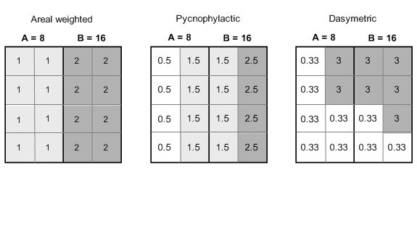
Modelling population distributions
Global gridded population datasets developed since the 1990s
Different modelling methods:
Areal weighted
Gridded Population of the World (GPW)
Notes:
Our knowledge of human distribution in many areas of the World remains surprisingly poor. A variety of methods for converting population count data from irregular administrative units to regular grids have been developed since the 1990s and have led to the emergence of differing global gridded population datasets.
Population distribution modelling methods over large spatial scales rely on redistributing populations within census units to obtain continuous population surfaces, i.e. gridded datasets with a number of inhabitants per grid cell. Different interpolation methods have been typically used to reallocate populations within administrative units (figure 2):
Areal weighting assumes that the population is uniformly distributed within each administrative unit. The population assigned to a grid cell is simply the total population of the administrative unit divided by the number of cells in the administrative unit. Every grid cells of an administrative unit has therefore the same population value [45]. This method was used to construct the Gridded Population of the World (GPW) database, versions 2 and 3 [42, 46] (table 1).
Pycnophylactic interpolation starts with the areal weighted method, but smoothes population values using the weighted average of nearest neighbours, while preserving the summation of population data to the original population per areal unit [47]. Pycnophylactic interpolation was used to generate GPW version 1 [48, 49].
Dasymetric modelling involves using ancillary data – often this may include satellite derived land cover data – to redistribute populations within administrative units [45, 50]. Weightings are attributed to the different land cover classes and the population is redistributed accordingly. For example, the Global Rural Urban Mapping Project (GRUMP) uses a similar approach to GPW, but incorporates urban–rural extents and their corresponding populations in the spatial reallocation of census counts [43, 44]. The urban–rural extent information is generated by a variety of input data that include census data, online web sources and National Imagery and Mapping Agency (NIMA) database of populated places [46]. The recently produced AfriPop dataset [51], which covers the African continent at a fine spatial resolution, also used land cover data to redistribute populations [52]. Other kinds of ancillary data such as the slope or roads can be used for dasymetric mapping.
More sophisticated modelling approaches – called smart interpolation – involve modelling the finescale distribution of populations using a range of satellite and other ancillary data. For example, an accessibility surface developed from road networks and populated places can be used to redistribute people, as was done in the construction of the UNEP database [53–55]. The LandScan dataset is another example of smart interpolation, where various ancillary data such as roads, slope, land cover and nighttime lights are used to determine the probability of population occurrence in cells. Populations are spatially reallocated within each areal unit using modelling approaches based on these probability coefficients [56–58].

Slide 14
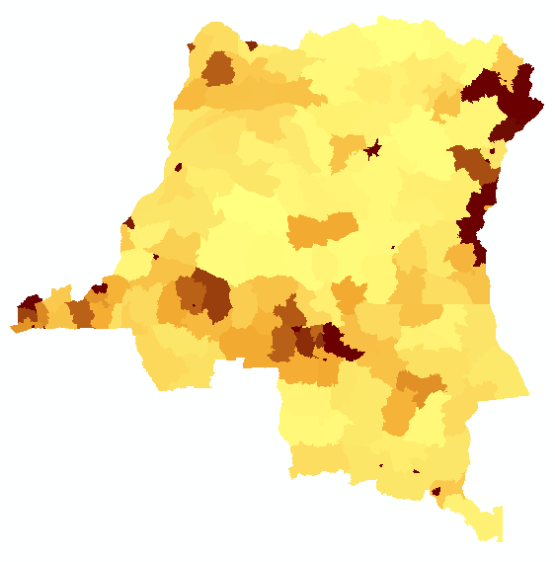

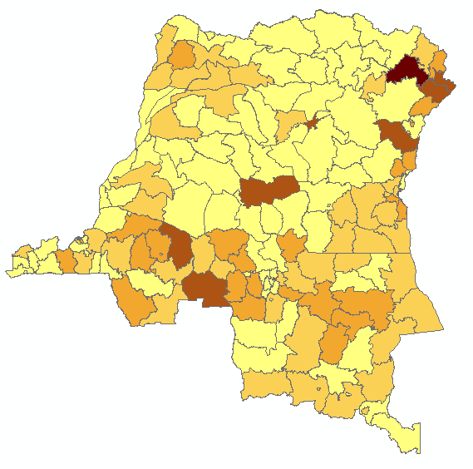
Areal weighting

Slide 15
Modelling population distributions
Global gridded population datasets developed since the 1990s
Different modelling methods:
Areal weighted
Dasymetric
Gridded Population of the World (GPW)
Global Rural Urban Mapping Project (GRUMP)
GHS-Pop
Notes:
Our knowledge of human distribution in many areas of the World remains surprisingly poor. A variety of methods for converting population count data from irregular administrative units to regular grids have been developed since the 1990s and have led to the emergence of differing global gridded population datasets.
Population distribution modelling methods over large spatial scales rely on redistributing populations within census units to obtain continuous population surfaces, i.e. gridded datasets with a number of inhabitants per grid cell. Different interpolation methods have been typically used to reallocate populations within administrative units (figure 2):
Areal weighting assumes that the population is uniformly distributed within each administrative unit. The population assigned to a grid cell is simply the total population of the administrative unit divided by the number of cells in the administrative unit. Every grid cells of an administrative unit has therefore the same population value [45]. This method was used to construct the Gridded Population of the World (GPW) database, versions 2 and 3 [42, 46] (table 1).
Pycnophylactic interpolation starts with the areal weighted method, but smoothes population values using the weighted average of nearest neighbours, while preserving the summation of population data to the original population per areal unit [47]. Pycnophylactic interpolation was used to generate GPW version 1 [48, 49].
Dasymetric modelling involves using ancillary data – often this may include satellite derived land cover data – to redistribute populations within administrative units [45, 50]. Weightings are attributed to the different land cover classes and the population is redistributed accordingly. For example, the Global Rural Urban Mapping Project (GRUMP) uses a similar approach to GPW, but incorporates urban–rural extents and their corresponding populations in the spatial reallocation of census counts [43, 44]. The urban–rural extent information is generated by a variety of input data that include census data, online web sources and National Imagery and Mapping Agency (NIMA) database of populated places [46]. The recently produced AfriPop dataset [51], which covers the African continent at a fine spatial resolution, also used land cover data to redistribute populations [52]. Other kinds of ancillary data such as the slope or roads can be used for dasymetric mapping.
More sophisticated modelling approaches – called smart interpolation – involve modelling the finescale distribution of populations using a range of satellite and other ancillary data. For example, an accessibility surface developed from road networks and populated places can be used to redistribute people, as was done in the construction of the UNEP database [53–55]. The LandScan dataset is another example of smart interpolation, where various ancillary data such as roads, slope, land cover and nighttime lights are used to determine the probability of population occurrence in cells. Populations are spatially reallocated within each areal unit using modelling approaches based on these probability coefficients [56–58].

Slide 16
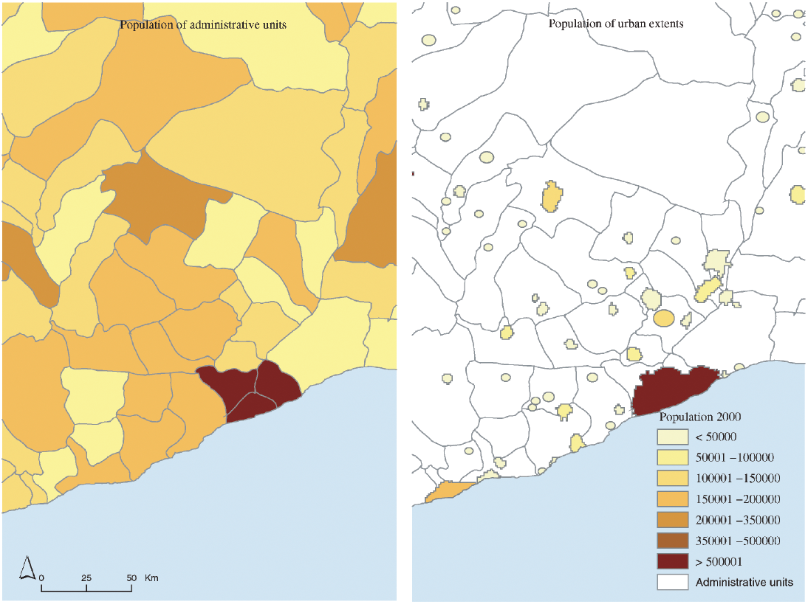
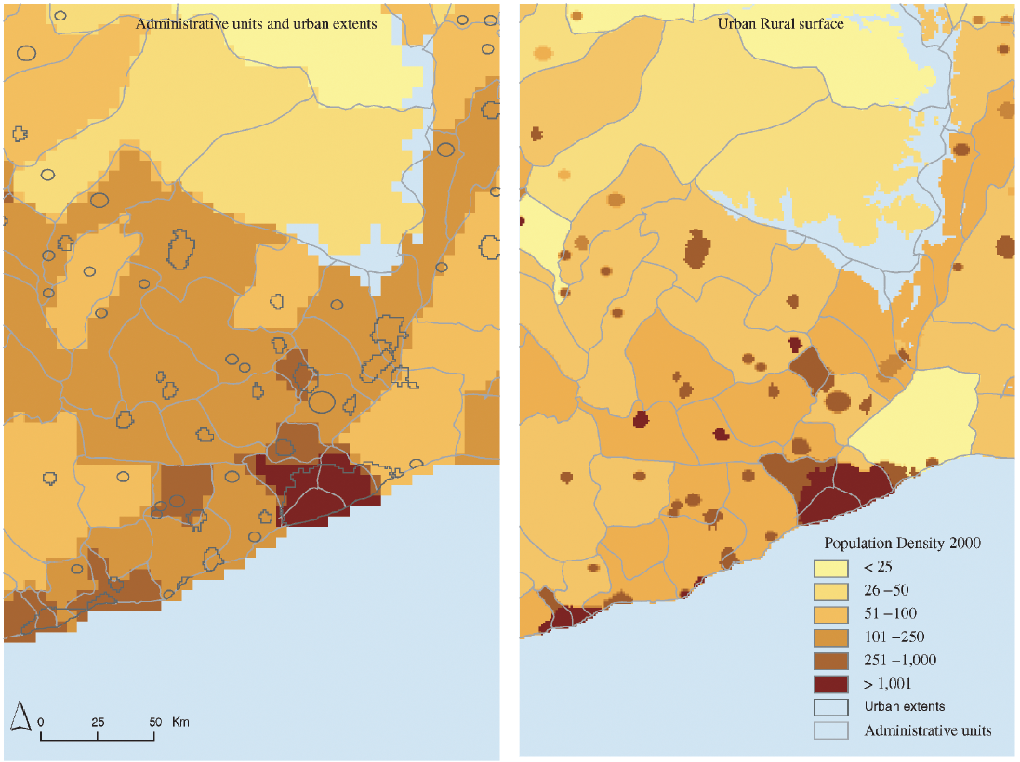
Dasymetric (single ancillary data layer)

Slide 17

Modelling population distributions
Global gridded population datasets developed since the 1990s
Different modelling methods:
Areal weighted
Dasymetric
Multivariate regression-type approaches
Gridded Population of the World (GPW)
Global Rural Urban Mapping Project (GRUMP)
GHS-Pop
WorldPop
LandScan
Notes:
Our knowledge of human distribution in many areas of the World remains surprisingly poor. A variety of methods for converting population count data from irregular administrative units to regular grids have been developed since the 1990s and have led to the emergence of differing global gridded population datasets.
Population distribution modelling methods over large spatial scales rely on redistributing populations within census units to obtain continuous population surfaces, i.e. gridded datasets with a number of inhabitants per grid cell. Different interpolation methods have been typically used to reallocate populations within administrative units (figure 2):
Areal weighting assumes that the population is uniformly distributed within each administrative unit. The population assigned to a grid cell is simply the total population of the administrative unit divided by the number of cells in the administrative unit. Every grid cells of an administrative unit has therefore the same population value [45]. This method was used to construct the Gridded Population of the World (GPW) database, versions 2 and 3 [42, 46] (table 1).
Pycnophylactic interpolation starts with the areal weighted method, but smoothes population values using the weighted average of nearest neighbours, while preserving the summation of population data to the original population per areal unit [47]. Pycnophylactic interpolation was used to generate GPW version 1 [48, 49].
Dasymetric modelling involves using ancillary data – often this may include satellite derived land cover data – to redistribute populations within administrative units [45, 50]. Weightings are attributed to the different land cover classes and the population is redistributed accordingly. For example, the Global Rural Urban Mapping Project (GRUMP) uses a similar approach to GPW, but incorporates urban–rural extents and their corresponding populations in the spatial reallocation of census counts [43, 44]. The urban–rural extent information is generated by a variety of input data that include census data, online web sources and National Imagery and Mapping Agency (NIMA) database of populated places [46]. The recently produced AfriPop dataset [51], which covers the African continent at a fine spatial resolution, also used land cover data to redistribute populations [52]. Other kinds of ancillary data such as the slope or roads can be used for dasymetric mapping.
More sophisticated modelling approaches – called smart interpolation – involve modelling the finescale distribution of populations using a range of satellite and other ancillary data. For example, an accessibility surface developed from road networks and populated places can be used to redistribute people, as was done in the construction of the UNEP database [53–55]. The LandScan dataset is another example of smart interpolation, where various ancillary data such as roads, slope, land cover and nighttime lights are used to determine the probability of population occurrence in cells. Populations are spatially reallocated within each areal unit using modelling approaches based on these probability coefficients [56–58].

Slide 18
Census data disaggregation
Census counts generally aggregated at coarse, irregular administrative unit level, making integration and comparisons with other data challenging
Integration with satellite/GIS data related to human population distribution patterns to disaggregate counts to regular grids using machine learning
Notes:
Mapping populations per grid square provides a detailed and consistent dataset for integration with other datasources – e.g. population-environment interactions, healthcare access. Here, we show how aggregated census counts can be disaggregated to a grid square representation through exploiting the relationships between population densities and the range of satellite and GIS datasets presented earlier. The outputs are 100x100m estimates of total numbers of residents and their breakdowns by age and sex, as well as full metadata describing methods, input datasets and accuracy assessments, and are freely available from www.worldpop.org, while the computer code used to produce the outputs is freely available. As the approach is disaggregating counts from census data linked to administrative boundaries, the importance of using reliable census numbers enumerated at a high administrative unit level remain as a key determinant of outputs mapping accuracies. The output datasets have been used in multiple international reports by UN agencies and others, as well as substantial government usage within countries. This is being scaled globally to produce freely available gridded age-sex structured population data.

Slide 19
Why and when to use top-down?
Need for small area estimates that match official/other estimates at larger levels of aggregation
Need for estimates that can be distributed openly
Need for estimates that can be integrated with other datasets

Slide 20
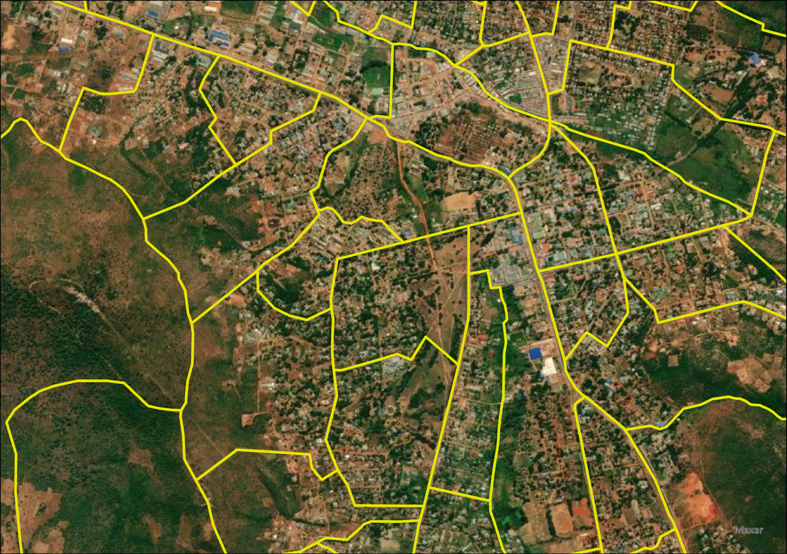
Enumeration areas

Slide 21
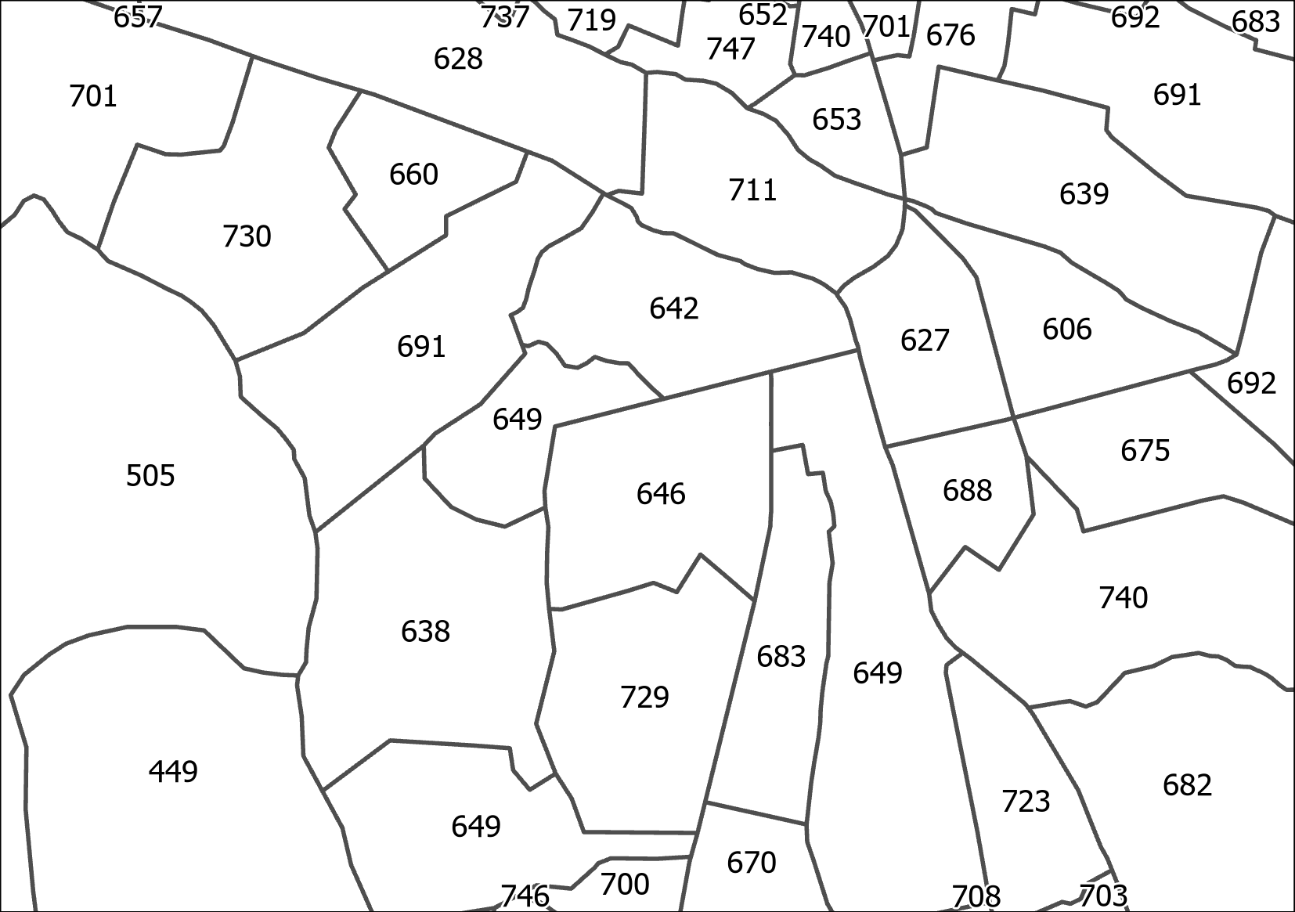
Enumeration area population

Slide 22
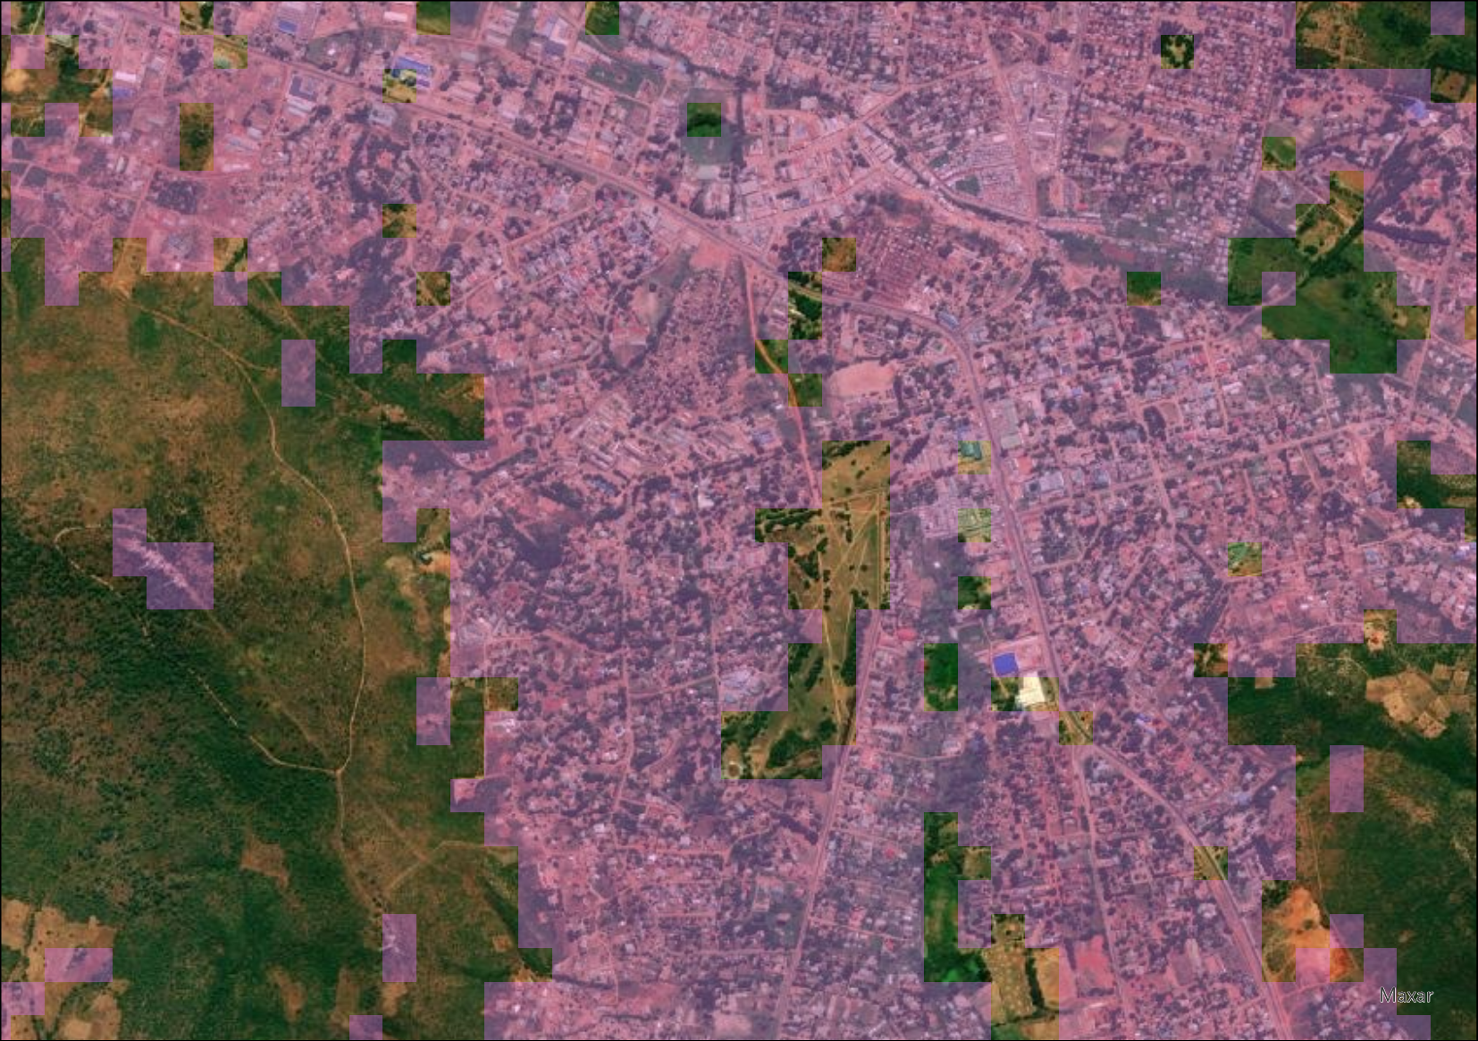
Constrain to areas of settlement - e.g. derived from building footprints

Slide 23
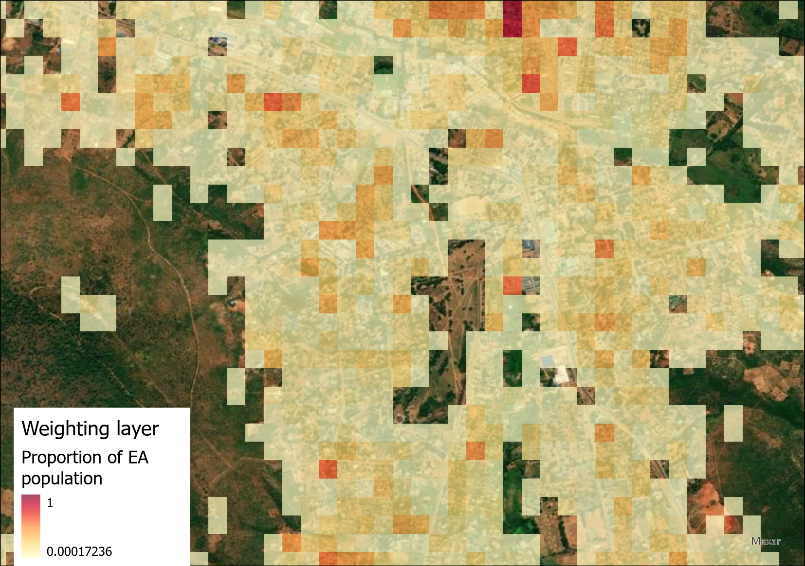
Weighting layer - the proportion of the EA population that should be allocated to each grid cell

Slide 24
Enumeration area population

Slide 25
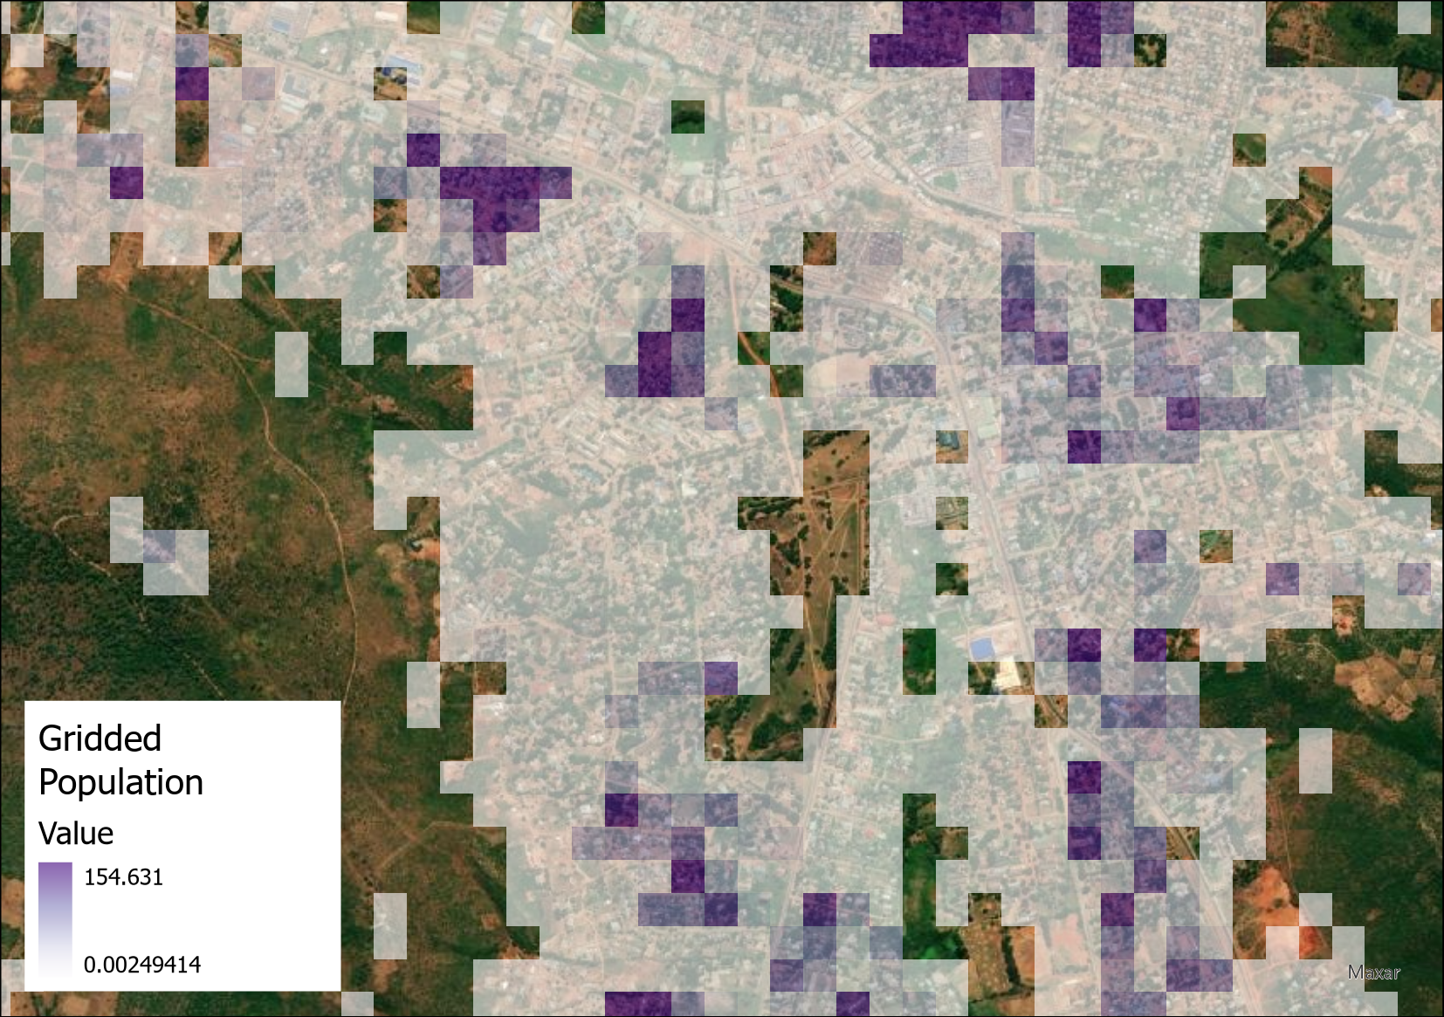
Output gridded population estimates

Slide 26
Gridded population datasets
From EA level data to gridded estimates
EA population
Gridded population estimates

Slide 27
Top-down estimation
Area-level population
Weighting layer
Gridded population estimates

Slide 28
Top-down estimation
?
Area-level population
Weighting layer
Gridded population estimates

Slide 29
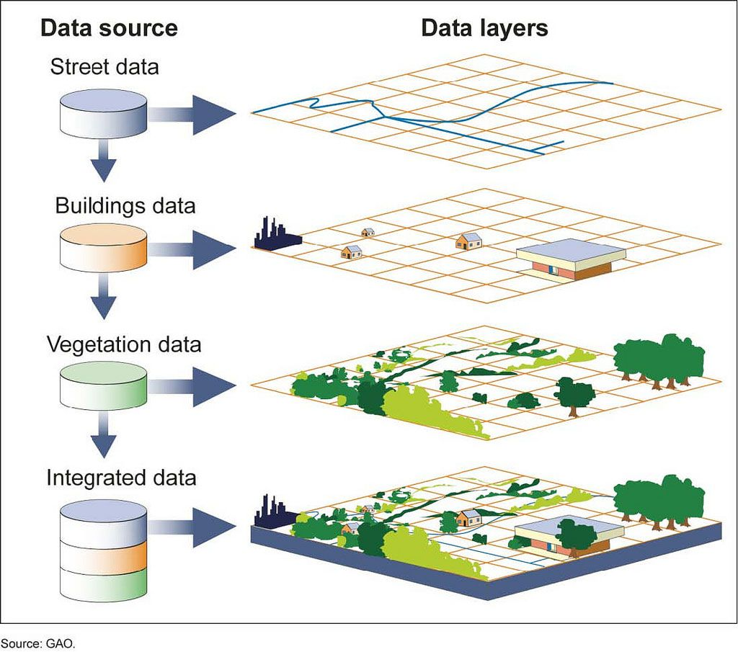

Slide 30
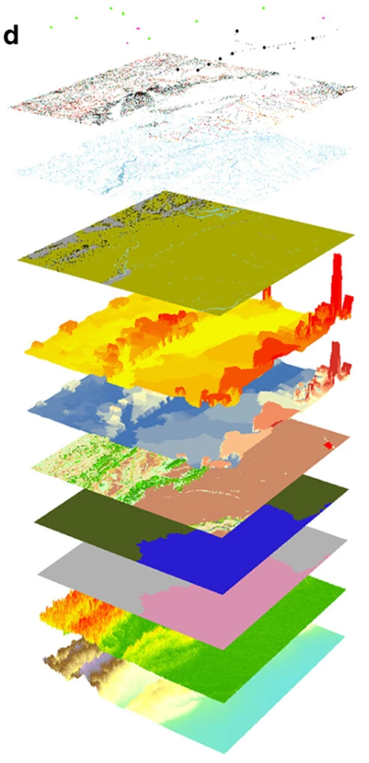
Deriving a weighting layer
The weighting layer needs to be created from predictive variables (geospatial covariates) related to population density, and associated with the built and natural environment
Geospatial covariates are spatially harmonised so that all variables have the same spatial resolution and grid cell alignment → geospatial covariate stack
Select the subset of geospatial covariates that are most strongly correlated with population density
Geospatial covariate stack

Slide 31
Examples of geospatial covariates
→ Natural environment
Distance from rivers
Vegetation greenness
→ Built environment
Distance from roads
Deriving metrics from building footprints:
Building count
Building area (min, max, mean, total, sd)
Building perimeter (min, max, mean, total, sd)
Count of building vertices (min, max, mean, total, sd)

Slide 32
Geospatial covariates
Select the most strongly correlated (most predictive) subset of covariates, from which the weighting layer is created.
The standard WorldPop approach is to use a random forest model (a machine learning algorithm) to identify the most predictive subset of covariates and their weightings.
We typically find that covariates derived from building footprints are strong predictors
Focus on covariates later

Slide 33
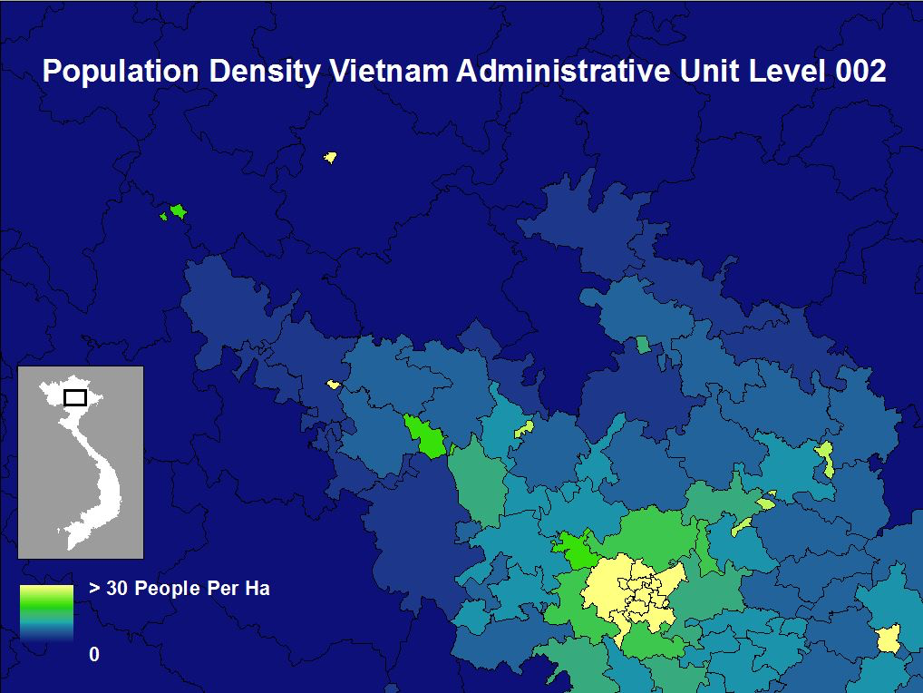
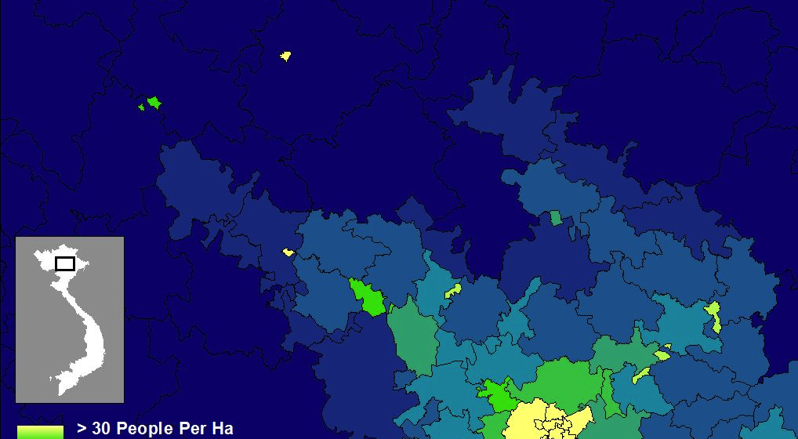
Example enumeration data
Notes:
Start with census counts (relatively fine resolution counts here for Vietnam for this example, but many countries coarser than this)

Slide 34
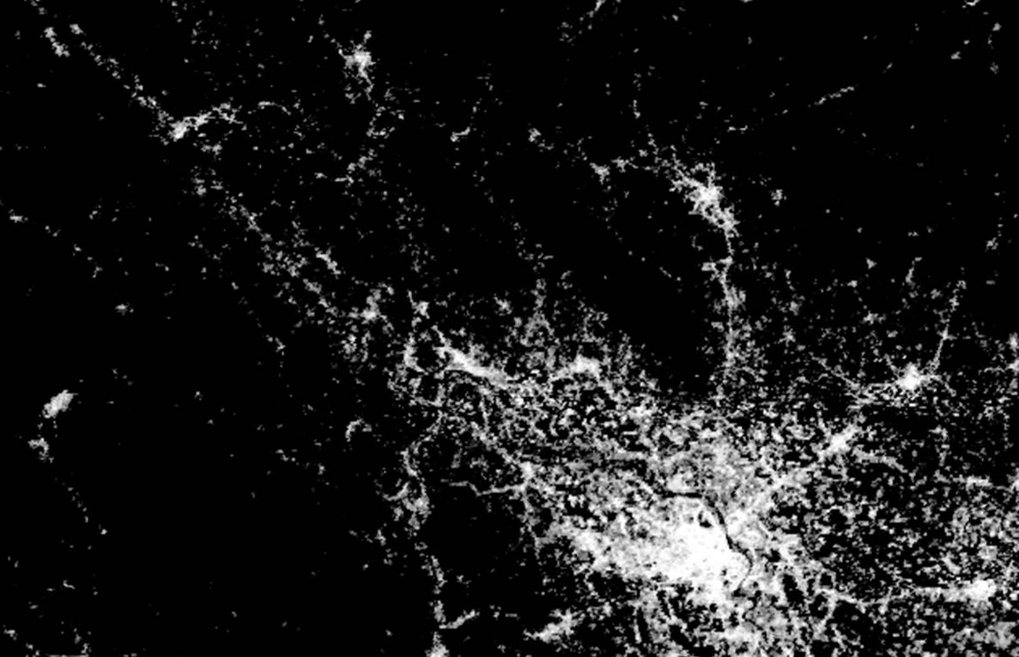
Global Human Settlement Layer
Building footprint/settlement mapping from satellites

Slide 35
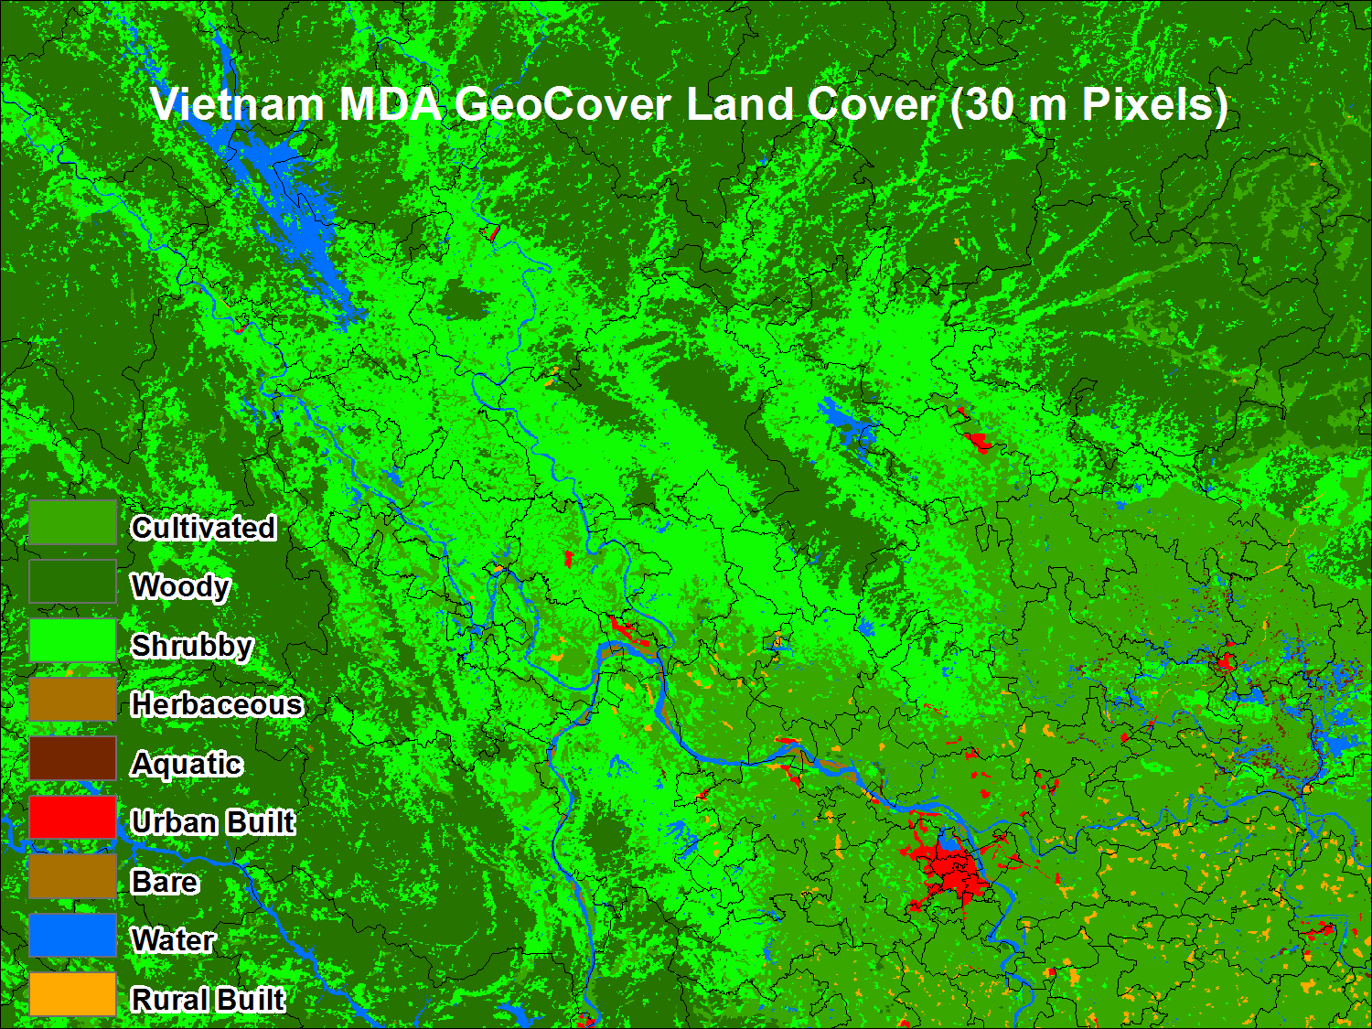
Land cover data
Notes:
Land cover = one of many covariates

Slide 36
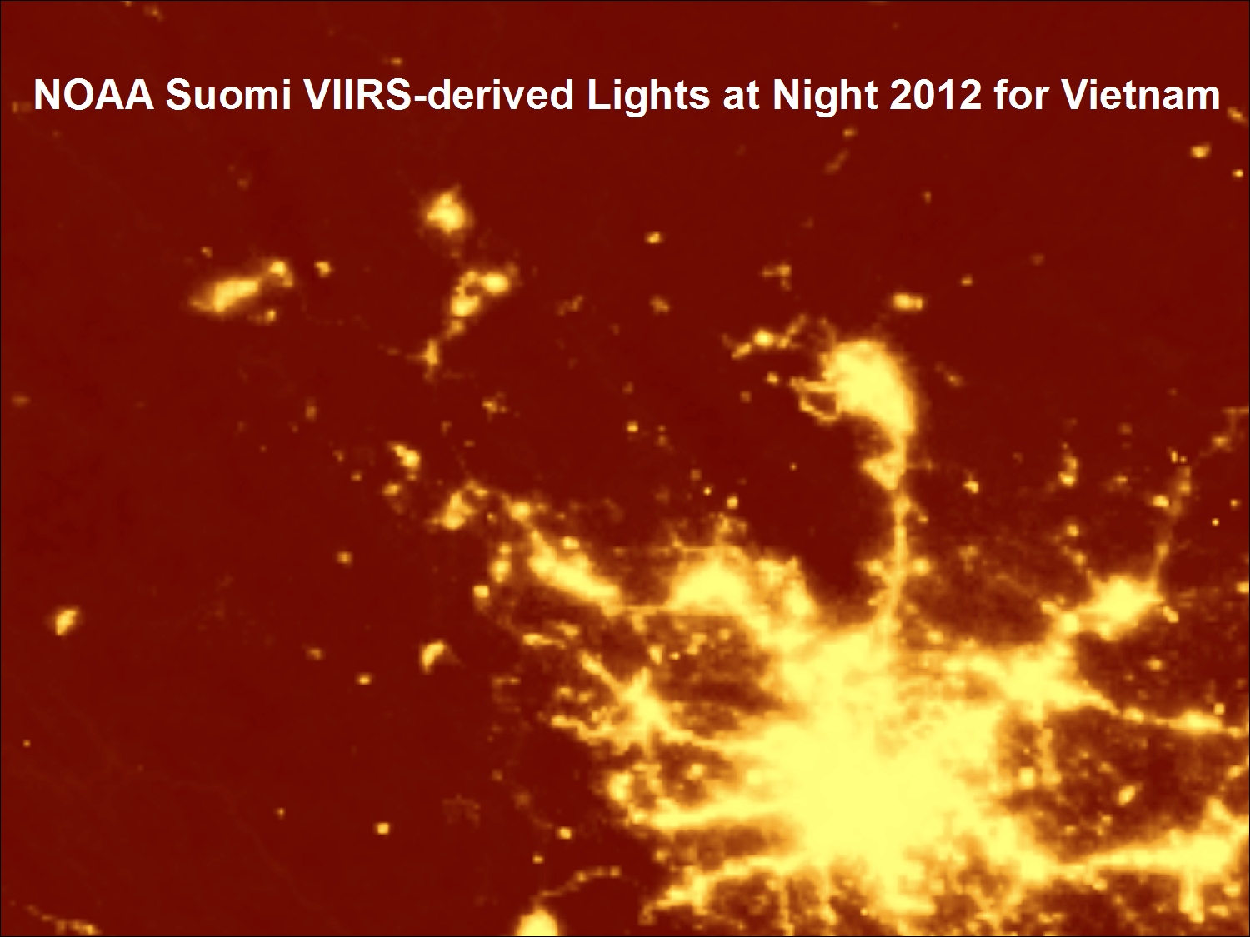
Satellite nightlights
Notes:
Night lights = one of many covariates

Slide 37
Example enumeration data
Notes:
So starting from aggregated counts like this…..

Slide 38
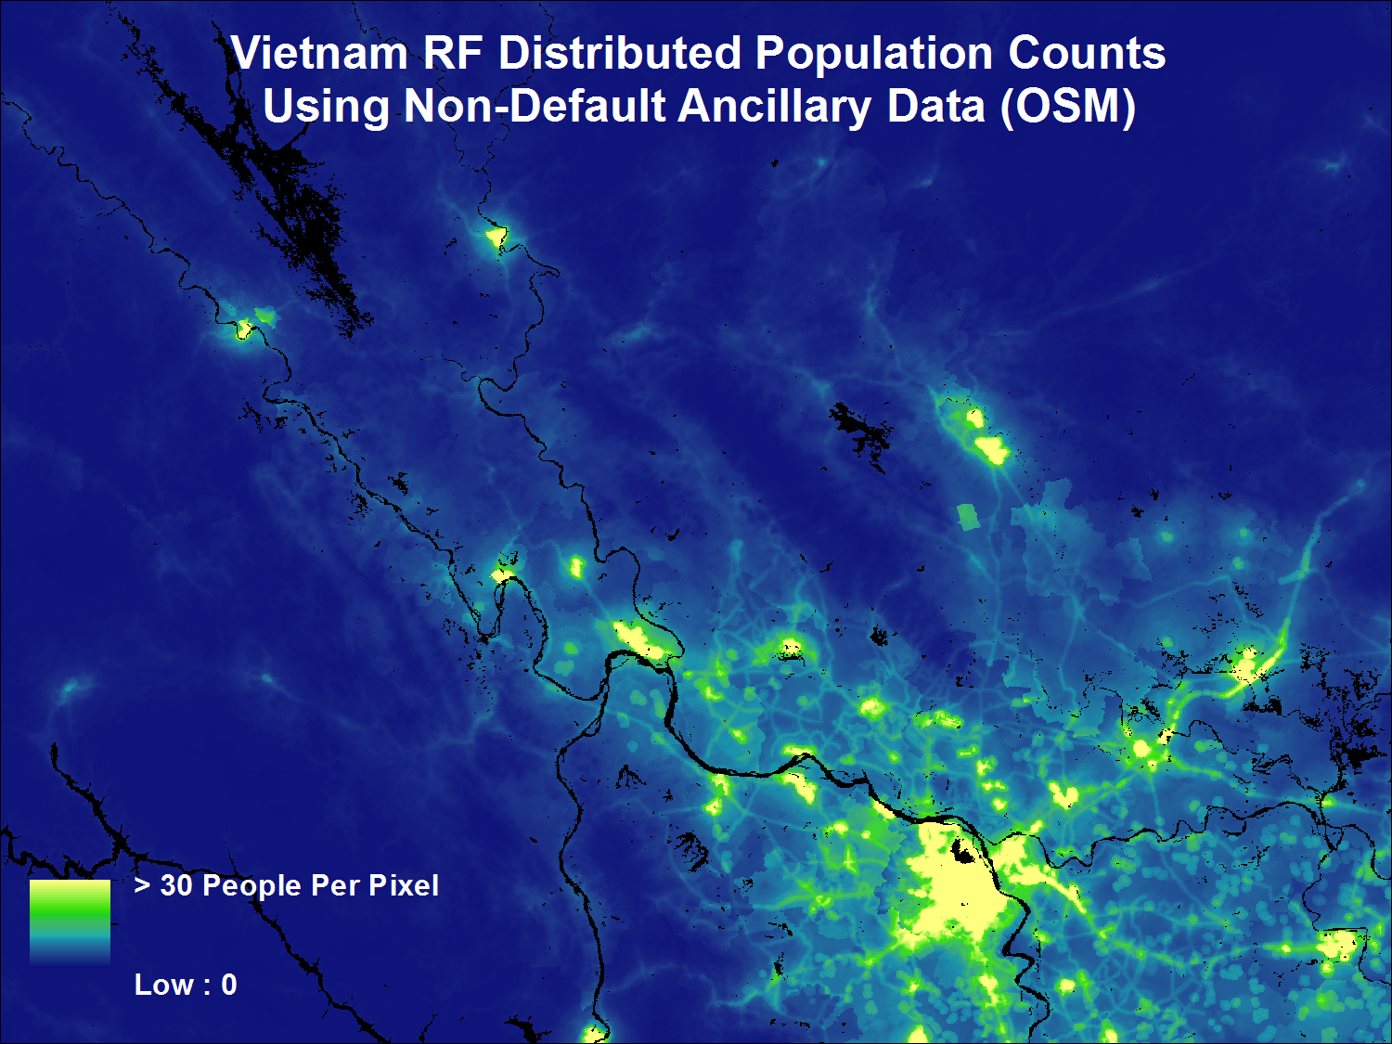
Estimated population counts per 100 x 100m grid square
Notes:
….we go to 100m estimates like this. Of course benefit of gridded data is summarisation by any admin unit, or other level of aggregation needed = flexibility.

Slide 39
Practical – creating a covariate to help define weightings
In small groups or pairs, examine the satellite image in one of your sheets
You are aiming to make a covariate – in this case, estimated population density classes
For each grid square, give a value of 1-6 depending on how many people you think are residing there – fill this out in the grid on your other sheet of paper
You will need to make assumptions based on what you see – Land use? Residential building? Building height?

Slide 40
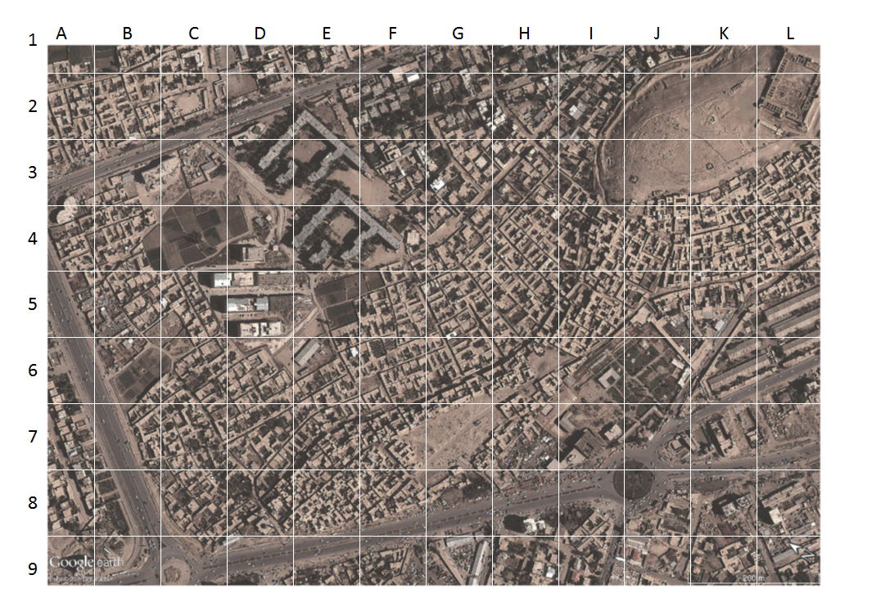

Slide 41
No buildings
Tall buildings
Non-residential buildings?
High building density

Slide 42
1
1
1
2
2
3
2
2
1
1
1
1
1
1
1
1
2
4
4
4
1
1
1
1
1
1
2
1
4
5
5
5
4
1
2
1
2
1
1
3
2
4
6
6
5
3
3
3
4
4
1
1
3
3
2
5
6
5
4
3
2
2
4
2
2
1
3
4
3
4
5
5
4
3
1
1
2
2
1
2
1
1
2
4
4
3
1
1
1
1
1
1
2
2
1
1
2
2
2
1
1
1
1
1
1
1
1
1
1
1
2
1
1
1
1
1

Slide 43
400
600
600
300
500
250
700
600
Notes:
EA estimates are good, but gridded – advantages
Help to show within-EA variability e.g. non-settled areas
Urban vs rural – issues magnified where units are larger e.g. in rural areas

Slide 44
1
1
1
2
2
3
2
2
1
1
1
1
1
1
1
1
2
4
4
4
1
1
1
1
1
1
100 people
2
1
4
5
5
5
4
1
2
1
2
1
1
3
2
4
6
6
5
3
3
3
4
4
1
1
150 people
3
3
2
5
6
5
4
3
2
2
4
2
2
100 people
1
3
4
3
4
5
5
4
3
1
1
2
2
1
2
1
1
2
4
4
3
1
1
1
1
1
1
2
2
1
1
2
2
2
1
1
1
1
1
1
1
1
1
1
1
2
1
1
1
1
1

Slide 45
What datasets could help us more accurately define our covariate?
No buildings
Land cover/use: Parks to use as mask
Tall buildings
Building heights, floors
Non-residential buildings?
High building density
Building use
Neighbourhood types, land use

Slide 46
What datasets could help us more accurately define our covariate?
Neighbourhood types, land use

Slide 48
Deriving a weighting layer
The weighting layer needs to be created from predictive variables (geospatial covariates) related to population density, and associated with the built and natural environment
Geospatial covariates are spatially harmonised so that all variables have the same spatial resolution and grid cell alignment → geospatial covariate stack
Select the subset of geospatial covariates that are most strongly correlated with population density
In WorldPop, we use a Random Forests algorithm to do this
Geospatial covariate stack

Slide 49
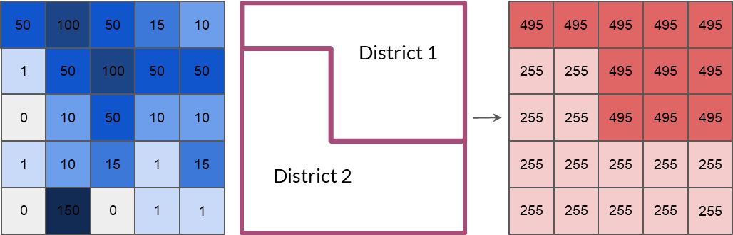
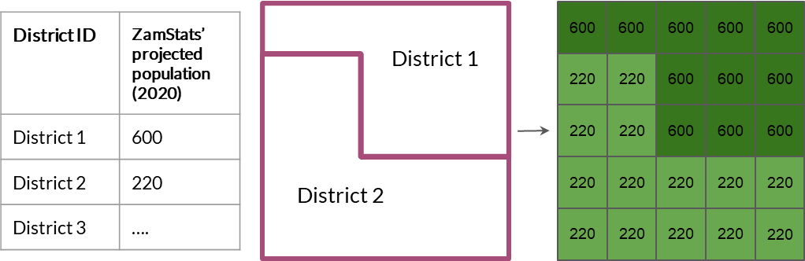
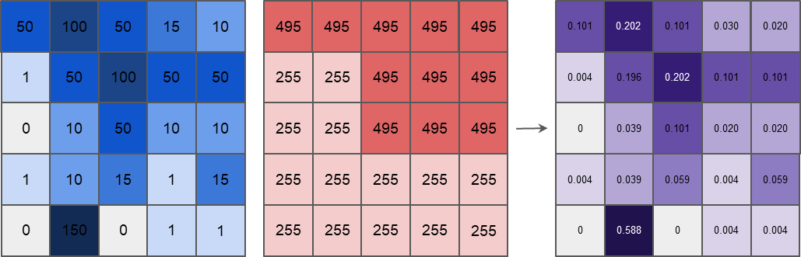
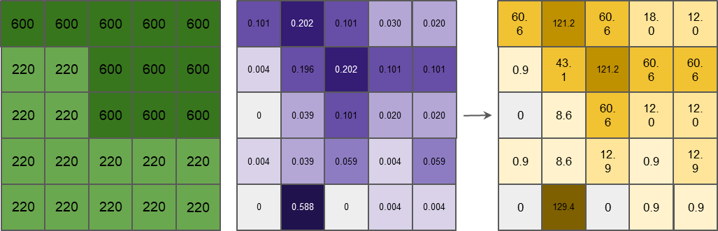
Part 1 and 2:
Data processing to create weighting layer
Part 3 and 4:
Apply weighting layer to spatially disaggregate
Aim: Determine relative spatial distribution of population within each input region
Output: weighting layer
Aim: Apply the weighting layer to allocate population within each input region, to grid cells within that region
Output: gridded population dataset

Slide 50
Input datasets
District ID | Projected population (2022)
District 1 | 600
District 2 | 220
District 3
…..
District 1
District boundaries (vector) with 2020 district population projections joined
Gridded covariate (e.g. building density)
District 2
50
100
50
15
10
1
50
100
50
50
0
10
50
10
10
1
10
15
1
15
0
150
0
1
1

Slide 51
Part 1
District boundaries (vector)
District 1
District 2

Slide 52
Part 1
Part 1
District boundaries (vector)
Covariate layer
50
100
50
15
10
District 1
1
50
100
50
50
0
10
50
10
10
1
10
15
1
15
District 2
0
150
0
1
1

Slide 53
Part 1
Summed district values calculated from covariate layer
50
100
50
15
10
0.020
0.030
495
0.101
495
495
0.202
495
0.101
District 1
495
1
50
100
50
50
0
10
50
10
10
0.004
255
0.196
255
0.202
495
0.101
495
0.101
495
1
10
15
1
15
District 2
0
150
0
1
1
0
255
0.039
255
0.101
495
0.020
495
0.020
495
Covariate layer
District boundaries (vector)
NB: each grid cell within a district has the same value
0.004
255
0.039
255
0.059
255
0.004
255
0.059
255
District 1:
50+100+50+15+10+100+50+50+50+10+10 = 495
District 2:
1+50+0+10+1+10+15+1+15+0+150+0+1+1 = 255
0
255
0.588
255
0
255
0.004
255
0.004
255

Slide 54
Part 1
NB: each grid cell within a district has the same value
Summed district values calculated from covariate layer
50
100
50
15
10
495
495
495
495
495
1
50
100
50
50
255
255
495
495
495
0
10
50
10
10
255
255
495
495
495
1
10
15
1
15
255
255
255
255
255
0
150
0
1
1
255
255
255
255
255

Slide 55
Part 2
Raster C: Weighting layer
50
100
50
15
10
495
495
495
495
495
0.101
0.202
0.101
0.030
0.020
1
50
100
50
50
255
255
495
495
495
0
10
50
10
10
255
255
495
495
495
0.004
0.196
0.202
0.101
0.101
1
10
15
1
15
255
255
255
255
255
0
150
0
1
1
255
255
255
255
255
0
0.039
0.101
0.020
0.020
Raster A:
Covariate layer
Raster B:
Summed district values calculated from covariate layer
0.004
0.039
0.059
0.004
0.059
Raster A
Raster B
=
Raster C
Grid cell value: the proportion of the summed district covariate values, calculated from the gridded estimates
0
0.588
0
0.004
0.004
50
495
=
0.101

Slide 56
Part 2
Raster C: Weighting layer
50
100
50
15
10
495
495
495
495
495
0.101
0.202
0.030
0.020
0.202
0.101
1
50
100
50
50
255
255
495
495
495
0
10
50
10
10
255
255
495
495
495
0.004
0.196
0.202
0.101
0.101
1
10
15
1
15
255
255
255
255
255
0
150
0
1
1
255
255
255
255
255
0
0.039
0.101
0.020
0.020
Raster A:
Covariate layer
Raster B:
Summed district values calculated from covariate layer
0.004
0.039
0.059
0.004
0.059
Raster A
Raster B
=
Raster C
Grid cell value: the proportion of the summed district covariate values, calculated from the gridded estimates
0
0.588
0
0.004
0.004
100
495
=
0.202

Slide 57
Part 2
Raster C: Weighting layer
50
100
50
15
10
495
495
495
495
495
0.101
0.202
0.030
0.020
0.202
0.101
1
50
100
50
50
255
255
495
495
495
0
10
50
10
10
255
255
495
495
495
0.004
0.004
0.196
0.202
0.101
0.101
1
10
15
1
15
255
255
255
255
255
0
150
0
1
1
255
255
255
255
255
0
0.039
0.101
0.020
0.020
Raster A:
Covariate layer
Raster B:
Summed district values calculated from covariate layer
0.004
0.039
0.059
0.004
0.059
Raster A
Raster B
=
Raster C
Grid cell value: the proportion of the summed district covariate values, calculated from the gridded estimates
0
0.588
0
0.004
0.004
1
255
=
0.004

Slide 58
Part 2
Raster C: Weighting layer
50
100
50
15
10
495
495
495
495
495
0.101
0.202
0.101
0.030
0.020
1
50
100
50
50
255
255
495
495
495
0
10
50
10
10
255
255
495
495
495
0.004
0.196
0.202
0.101
0.101
1
10
15
1
15
255
255
255
255
255
0
150
0
1
1
255
255
255
255
255
0
0.039
0.101
0.020
0.020
Raster A:
Covariate layer
Raster B:
Summed district values calculated from covariate layer
0.004
0.039
0.059
0.004
0.059
Raster A
Raster B
=
Raster C
Grid cell value: the proportion of the summed district covariate values, calculated from the gridded estimates
0
0.588
0
0.004
0.004

Slide 59
Part 3
District boundaries (vector) with projected population (2022) as an attribute
District ID | Projected population (2022)
District 1 | 600
District 2 | 220
District 3
…..
District 1
Projected population:
600
District 2
Projected population:
220

Slide 60
Part 3
Grid cell value: the projected district population total for the district that the grid cell is within - each grid cell within a district has the same value
District boundaries (vector)
Raster D: Projected district population total
600
600
600
600
600
District 1
Projected population:
600
220
220
600
600
600
220
220
600
600
600
220
220
220
220
220
District 2
Projected population:
220
220
220
220
220
220

Slide 61
Part 4
Raster E
600
600
600
600
600
0.101
0.202
0.101
0.030
0.020
60.6
18.0
18.0
60.6
121.2
60.6
220
220
600
600
600
0.004
0.196
0.202
0.101
0.101
220
220
600
600
600
0
0.039
0.101
0.020
0.020
0.9
43.1
121.2
60.6
60.6
220
220
220
220
220
0.004
0.039
0.059
0.004
0.059
220
220
220
220
220
0
0.588
0
0.004
0.004
0
8.6
60.6
18.0
18.0
Raster D:
Projected district population total (each grid cell within a district has same value)
Raster C:
Weighting layer
0.9
8.6
12.9
0.9
12.9
Raster C x Raster D = Raster E
600 x 0.101 = 60.6
0
129.4
0
0.9
0.9

Slide 62
Part 4
Raster E
600
600
600
600
600
0.101
0.202
0.101
0.030
0.020
60.6
18.0
18.0
60.6
121.2
121.2
60.6
220
220
600
600
600
0.004
0.196
0.202
0.101
0.101
220
220
600
600
600
0
0.039
0.101
0.020
0.020
0.9
43.1
121.2
60.6
60.6
220
220
220
220
220
0.004
0.039
0.059
0.004
0.059
220
220
220
220
220
0
0.588
0
0.004
0.004
0
8.6
60.6
18.0
18.0
Raster D:
Projected district population total (each grid cell within a district has same value)
Raster C:
Weighting layer
0.9
8.6
12.9
0.9
12.9
Raster C x Raster D = Raster E
600 x 0.202 = 121.2
0
129.4
0
0.9
0.9

Slide 63
Part 4
Raster E
600
600
600
600
600
0.101
0.202
0.101
0.030
0.020
60.6
18.0
18.0
60.6
121.2
121.2
60.6
220
220
600
600
600
0.004
0.196
0.202
0.101
0.101
220
220
600
600
600
0
0.039
0.101
0.020
0.020
0.9
0.9
43.1
121.2
60.6
60.6
220
220
220
220
220
0.004
0.039
0.059
0.004
0.059
220
220
220
220
220
0
0.588
0
0.004
0.004
0
8.6
60.6
18.0
18.0
Raster D:
Projected district population total (each grid cell within a district has same value)
Raster C:
Weighting layer
0.9
8.6
12.9
0.9
12.9
Raster C x Raster D = Raster E
220 x 0.004 = 0.9
0
129.4
0
0.9
0.9

Slide 64
Part 4
Raster E
600
600
600
600
600
0.101
0.202
0.101
0.030
0.020
60.6
121.2
60.6
18.0
12.0
220
220
600
600
600
0.004
0.196
0.202
0.101
0.101
220
220
600
600
600
0
0.039
0.101
0.020
0.020
0.9
43.1
121.2
60.6
60.6
220
220
220
220
220
0.004
0.039
0.059
0.004
0.059
220
220
220
220
220
0
0.588
0
0.004
0.004
0
8.6
60.6
12.0
12.0
Raster D:
Projected district population total (each grid cell within a district has same value)
Raster C:
Weighting layer
0.9
8.6
12.9
0.9
12.9
Raster C x Raster D = Raster E
0
129.4
0
0.9
0.9

Slide 65
Checking values
60.6
121.2
60.6
18.0
12.0
District 1
0.9
43.1
121.2
60.6
60.6
0
8.6
60.6
12.0
12.0
District 1
Summed total:
600
0.9
8.6
12.9
0.9
12.9
District 2
0
129.4
0
0.9
0.9
Raster E:
Adjusted population estimates (weighted to meet ZamStats district 2020 projections)
District boundaries (vector)
District 1:
60.6+121.2+60.6+18+12+121.2+60.6+60.6+60.6+12+12 = 600

Slide 66
Checking values
60.6
121.2
60.6
18.0
12.0
District 1
0.9
43.1
121.2
60.6
60.6
0
8.6
60.6
12.0
12.0
0.9
8.6
12.9
0.9
12.9
District 2
0
129.4
0
0.9
0.9
Raster E:
Adjusted population estimates (weighted to meet ZamStats district 2020 projections)
District boundaries (vector)
District 2:
0.9+43.1+8.6+0.9+8.6+12.9+0.9+12.9+129.4+0+0.9+0.9 = 220
District 2
Summed total:
220

Slide 67
Checking values
60.6
121.2
60.6
18.0
12.0
District 1
0.9
43.1
121.2
60.6
60.6
Projected population: 600
✔
District 1
Summed total:
600
0
8.6
60.6
12.0
12.0
0.9
8.6
12.9
0.9
12.9
District 2
Projected population: 220
✔
0
129.4
0
0.9
0.9
Raster E:
Adjusted population estimates (weighted to meet ZamStats district 2020 projections)
District boundaries (vector)
District 1:
60.6+121.2+60.6+18+12+121.2+60.6+60.6+60.6+12+12 = 600
= Projected population
District 2:
0.9+43.1+8.6+0.9+8.6+12.9+0.9+12.9+129.4+0+0.9+0.9 = 220
= Projected population
District 2
Summed total:
220

Slide 68
Output dataset
OUTPUT: District-disaggregated gridded population estimates
60.6
121.2
60.6
18.0
12.0
0.9
43.1
121.2
60.6
60.6
0
8.6
60.6
12.0
12.0
0.9
8.6
12.9
0.9
12.9
0
129.4
0
0.9
0.9

Slide 69
Output dataset
INPUT: covariate layer (raster) with district boundaries (vector) overlaid
District projected population: 600
OUTPUT: District-disaggregated gridded population estimates
50
100
50
15
10
60.6
121.2
60.6
18.0
12.0
1
50
100
50
50
0.9
43.1
121.2
60.6
60.6
0
10
50
10
10
District projected population: 220
0
8.6
60.6
12.0
12.0
1
10
15
1
15
0.9
8.6
12.9
0.9
12.9
0
150
0
1
1
0
129.4
0
0.9
0.9

Slide 70
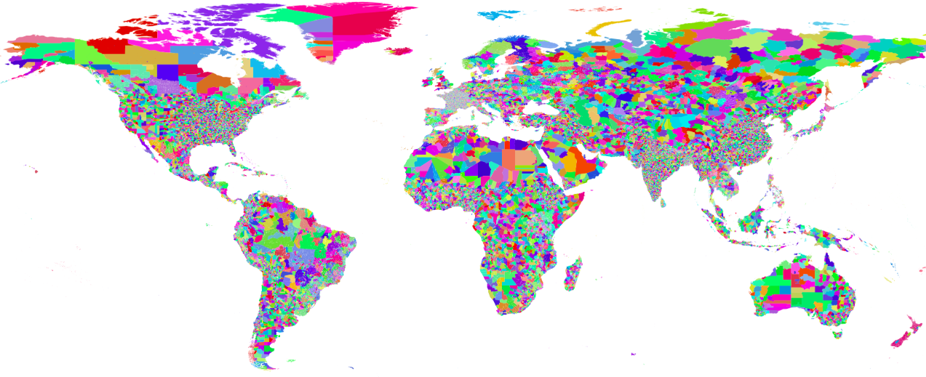


2000-2020 age/sex structured subnational census/projections
www.worldpop.org/resources/docs/national_boundaries/global-input-population-data-summary.xlsx

Slide 71
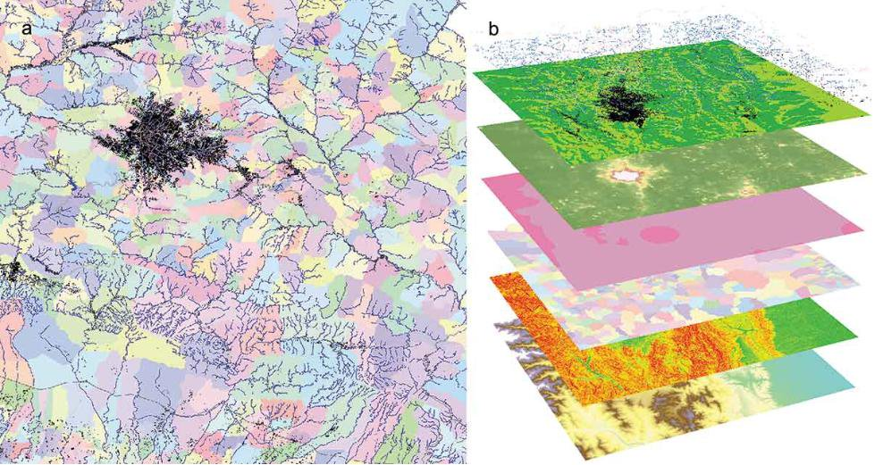
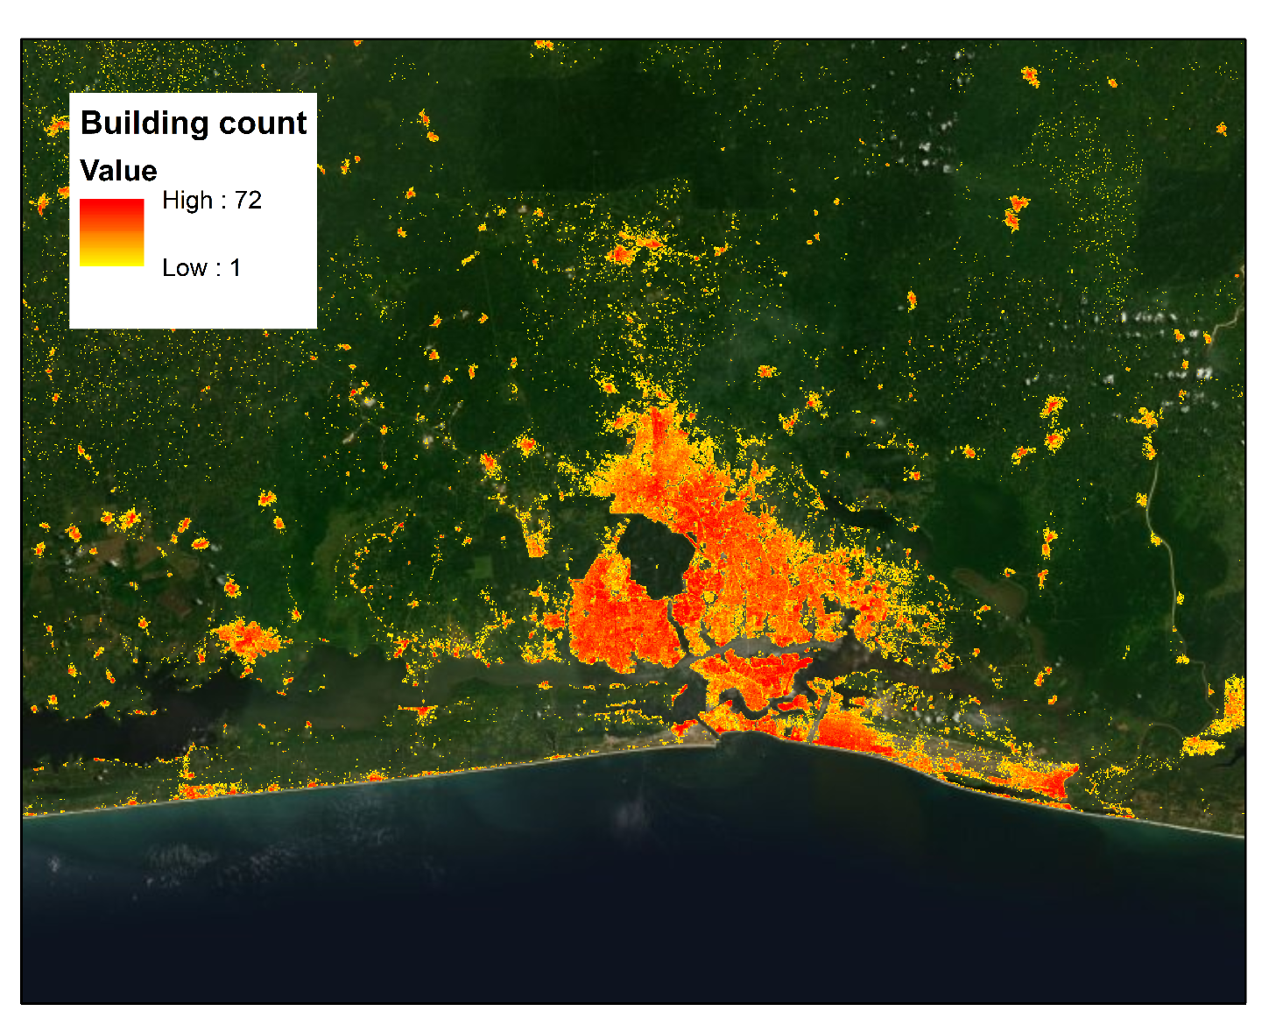
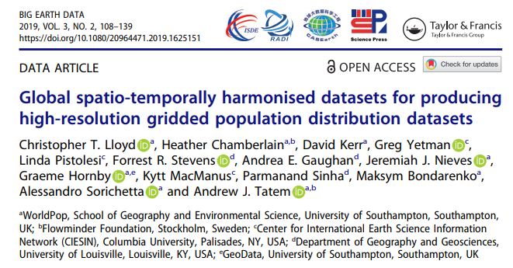
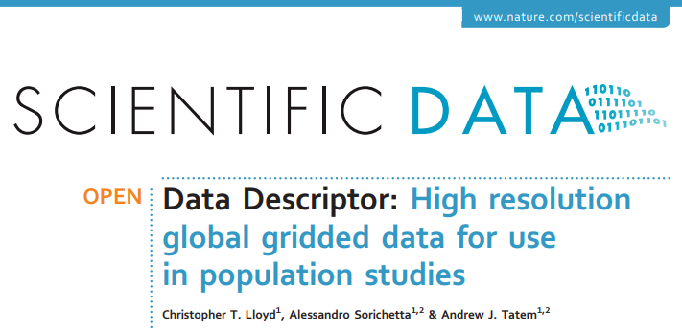
Geospatial library
www.worldpop.org
https://wopr.worldpop.org; Dooley et al (2020)

Slide 72
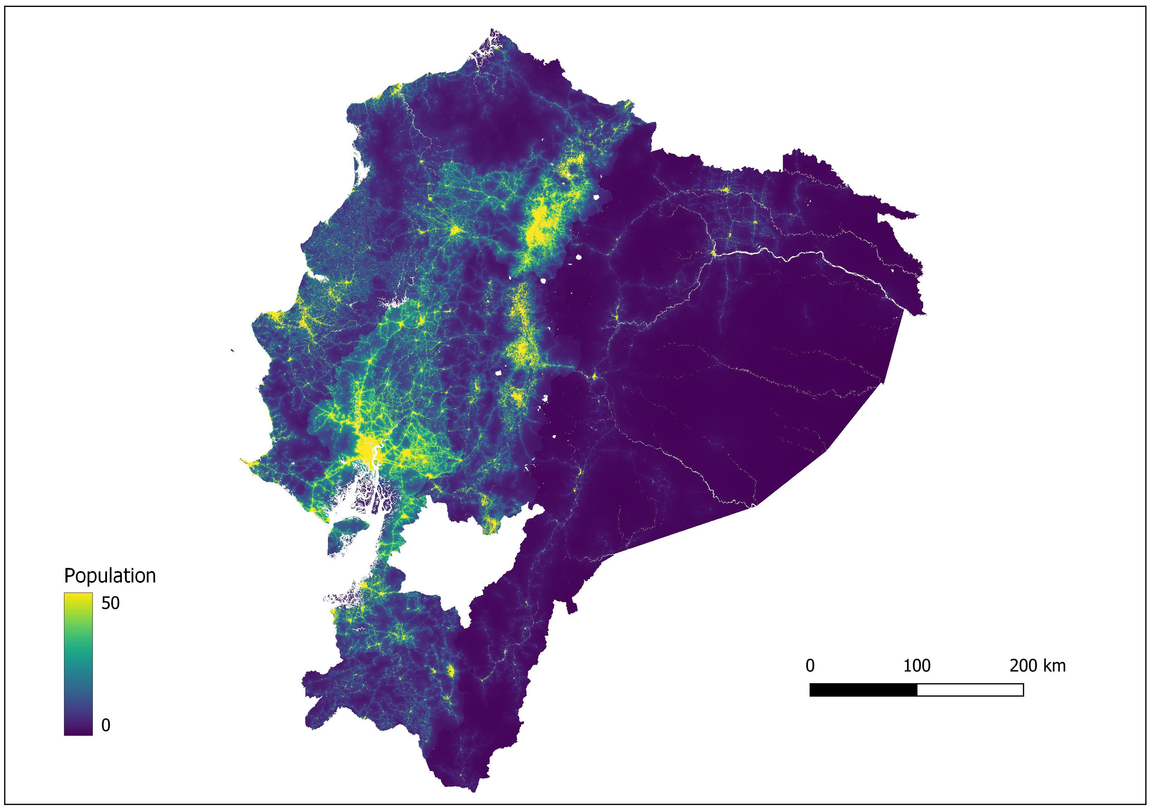
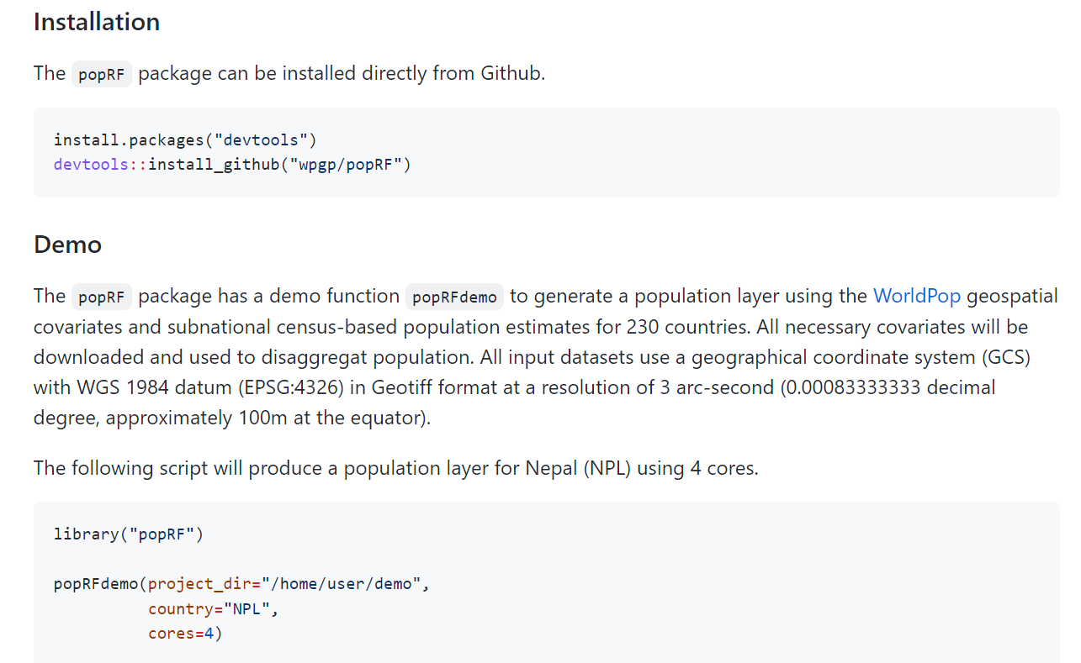
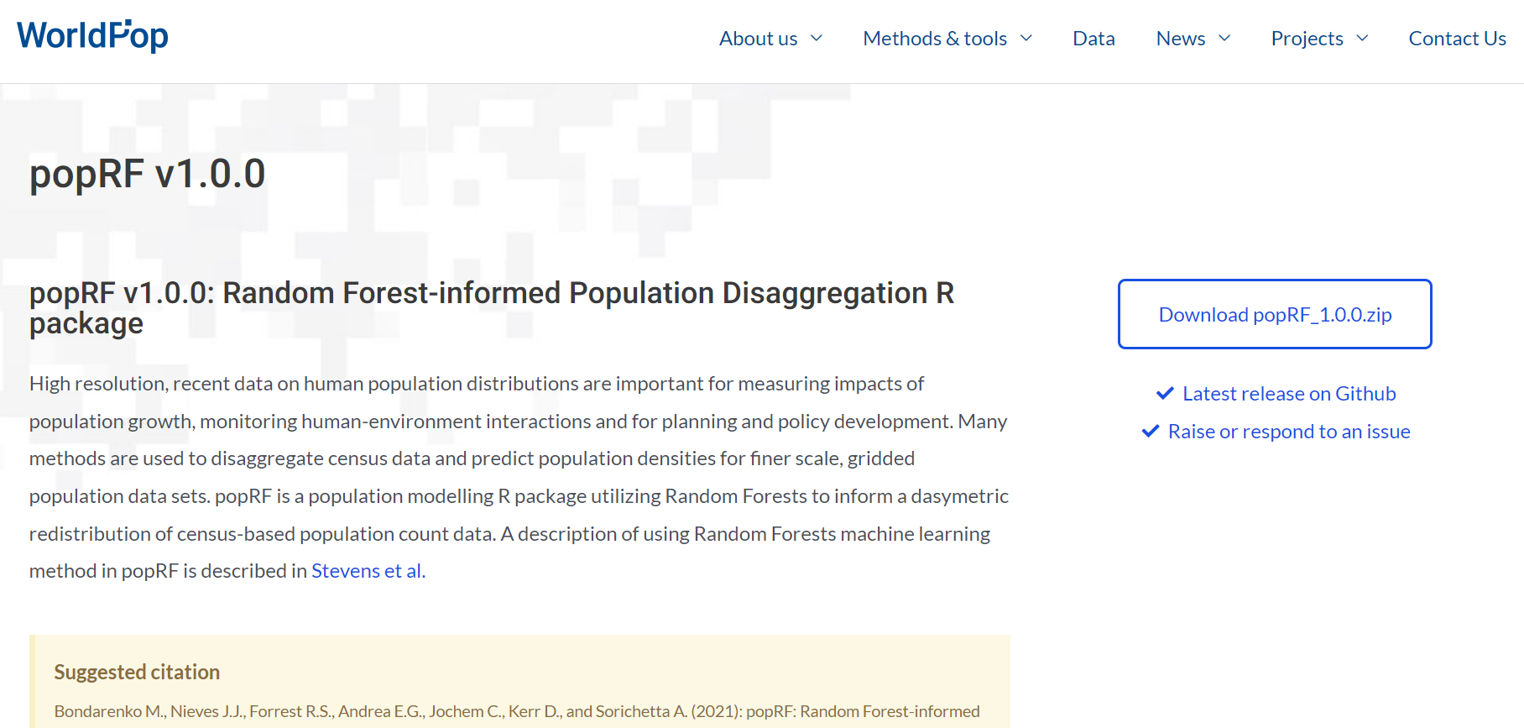
PopRF
https://github.com/wpgp/popRF/
https://www.worldpop.org/sdi/poprf_v1_0_0/

Slide 73
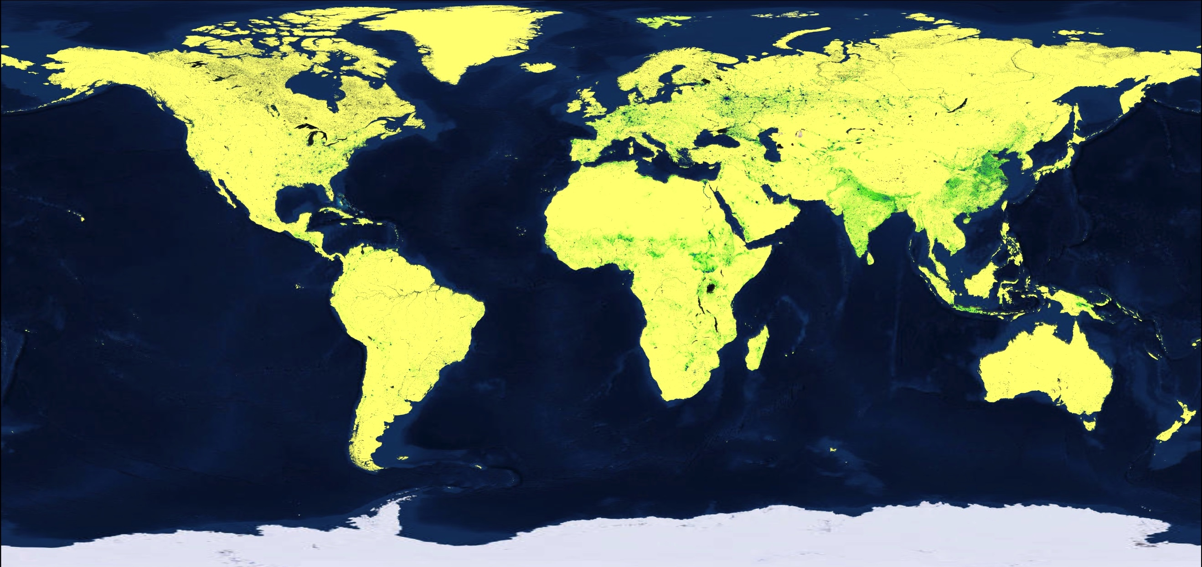
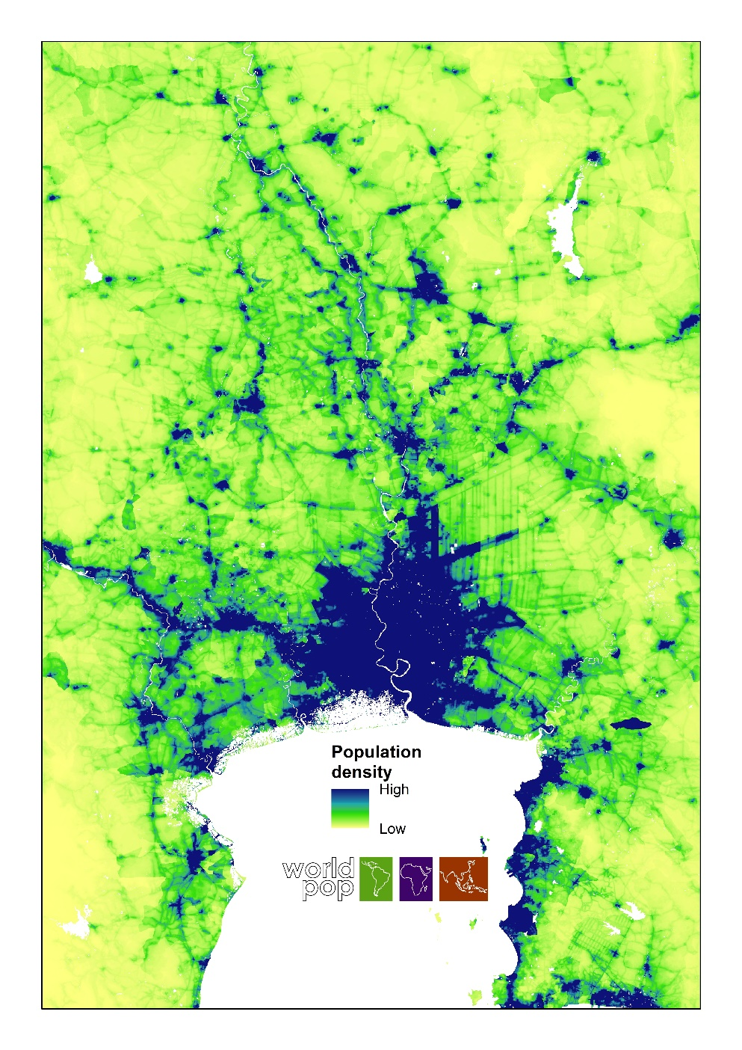
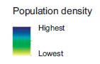
www.worldpop.org
Sorichetta et al (2017) Nature Sci Data; Gaughan et al (2017) Nature Sci Data

Slide 74
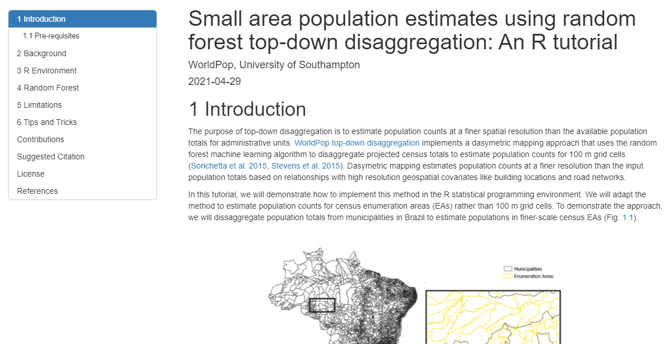

https://data.worldpop.org/repo/docs/leasure2021small/
https://data.worldpop.org/repo/docs/lazar2021poprf

Slide 75



Top-down disaggregation of other demographic characteristics?
https://journals.sagepub.com/doi/full/10.1177/0962280218797362

Slide 76
Limitations
If the population counts that we are disaggregating in our top-down model are inaccurate, then our population map will be too
We often cannot capture all relevant determinants of population density variations with our covariates
The model is only as good as the data it is trained on – if we have too few input units, and/or the range of population densities represented within them is narrow, then the output modelled estimates will be poor

Slide 77
Bottom-up modelling processes
1.
2.
3.
4.
5.
Exploration of settlement data/ creation of geospatial covariates
Model selection, model validation, population prediction/uncertainty quantification
Gridded population estimates, model documentation, report & paper
Data collation, preparation and data analyses
Development and exploration of various statistical model structures
Specific activities:
Specific activities:
Specific activities:
Specific activities:
Specific activities:
Data integration
Random intercept model development (STAN and INLA)
Observation-level prediction
Bayesian models with covariates (STAN and INLA)
Observation-level predictions
Data cataloging
Data cleaning
Variable description
Variable preparation
Shapefile cleaning
Data visualization
Exploratory analyses
Results presentation/discussion
Raster visualization
Raster cleaning
Various raster analyses
Covariates checks
Correlation analysis
Raster stacking
Other activities
Model checks and testing
Model selection
Cross-validation
Population prediction
Uncertainty quantification
Population gridding production
Model outline documentation
Report writing
Manuscript preparation for scientific publication

Slide 78
Data processing to create weighting layer
Part 1 and Part 2:
Process the raster data to create a weighting layer.
The weighting layer tells us what proportion of the population in each input region (e.g. District) should be allocated to each grid cell within that input region.
A weighting layer should therefore reflect the spatial distribution of population across the landscape.
weighting layer

Slide 79
Apply weighting layer to spatially disaggregate
Part 3 and Part 4:
To apply the weighting layer, we first create a raster (gridded dataset) where all grid cells in an input region have the same value, equal to population total for that region.
We then multiply that raster by the weighting layer, so that the total population is allocated proportionally to grid cells.
Output gridded population data

Slide 80
Part 1 and 2:
Data processing to create weighting layer
Part 3 and 4:
Apply weighting layer to spatially disaggregate
Aim: Determine relative spatial distribution of population within each input region
Output: weighting layer
Aim: Apply the weighting layer to allocate population within each input region, to grid cells within that region
Output: gridded population dataset

Slide 81

Bottom-up model

Slide 82
Bottom-up model
Settlement data
Population counts
Integrated geospatial covariates
Regression-type Bayesian statistical modelling
Predicted population counts

Slide 83
Bottom-up model
Building footprint (Building count, Building area, building height, etc)
Distance from market
Distance from health facilities
Night time lights
Topography
+ many more
Household surveys
Administrative data
Microcensus
Census
Predicted populations on 100m by 100m grid cells
Population density = covariates + Error

Slide 84

Notes:
[30s - overview only ]
The bottom up modelling combines data from localised population counts with satellite imagery into a statistical model that creates gridded population estimates at a 100x100m resolution. By matching data from satellites to data that’s verified on the ground through a microcensus (a microcensus being a set of complete population counts collected within small areas that are sampled from across a country), we can use that information in our model to estimate population data for areas that haven’t had a microcensus.
In this section, we will look in more detail over the input data required to produce gridded estimates.

Slide 85
Bottom-up model
Q: Why is population density preferred as the dependent variable instead of population count?
A:
Transformed population density often shows better relationship between with the scaled covariates
Corrects for overdispersion within the population count data

Slide 86
Bottom-up model
Population density is calculated as Population count divided by building area or divided by building count

Slide 87
Bottom-up model
Population density
Log(Population density)
Slope
Scaled slope

Slide 88



Resident Count | 255 people
Area | 7,0 hectares
Settled area | 3,5 hectares
Population density | 72 people/hectare
Parameters:
Pop density x Settled area
Populoation
Count
Population density
Settled area
Model structure

Slide 89

Predictors
Covariates
Population density

Slide 90
Poisson-Lognormal distribution
Model structure
Geospatial covariates
Population density
Settlement
type
LGA
Region
State

Slide 91


Settlement type
Urban
Rural
Village
Hierarchical Setting

Slide 92
Resident count
Geospatial covariates
Pop density
Settled area
Settlemnt
type
Region
LGA
State
Model structure

Slide 93
PEOPLE IMPUTATION
POPULATION
(count)
AGE/ SEX ESTIMATES
HIERACHICAL ESTIMATES
BUILDING FOOTPRINT ERROR
BUILT-UP AREA (hectare)
POPULATION DENSITY
(count/
Area)
WEIGHTED PRECISION
BUILDING TYPE
Hierarchical
intercept and variance
GEOSPATIAL COVARIATES
SETTLEMENT TYPE
ADMIN BOUNDARIES
MODEL-BASED VARIABLE SELECTION?
Notes:
The white boxes show the model parameters. The dashed outlines the estimates

Slide 94
PEOPLE IMPUTATION
POPULATION
(count)
AGE/ SEX ESTIMATES
HIERACHICAL ESTIMATES
BUILDING FOOTPRINT ERROR
BUILT-UP AREA (hectare)
POPULATION DENSITY
(count/
Area)
WEIGHTED PRECISION
MIGRATION?
BUILDING TYPE
Hierarchical
intercept and variance
NORMADIC POPULATION?
GEOSPATIAL COVARIATES
SETTLEMENT TYPE
ADMIN BOUNDARIES
MODEL-BASED VARIABLE SELECTION?
DISPLACED POPULATION?
Notes:
The white boxes show the model parameters. The dashed outlines the estimates

Slide 95


Cluster 1
Cluster 2
Settlement density | low
Settlement density | high
Mean slope | high
Mean slope | low
Nightlights | low
Nightlights | high
Distance to urban centre | high
Distance to urban centre | low
Relationship to population
Notes:
For example,to describe the difference in pop counts betwen the two clusters, we could use :
The slope: with cluster 1 having a high slope and cluster 2 being on a flat land
Nightlights, or distance to urban centres.

Slide 96
Cluster 1
Cluster 2
C2
Population Size
C1
Population size | 500 people
Settlement density| low
Population size| 1,000 people
Settlement density | high
Settlement Density
Relationship to population
Notes:
We have two clusters (surveyed areas)
One in a desertic area with few settlements as shown by the satellite imagery. We know from the survey (the microcensus) that the pop of the first cluster is 500 people. The settlement density is low.
The other cluster is in a town, and the micro census listed 1000 people. For this cluster, the settlement density is high
We can then represent them on a graph, linking settlement density to pop size
We can plot the info for all clusters and model the relationship between these two input data.

Slide 97

Prediction in unsurveyed area
Uncertainty
Population size
Settlement layer
Relationship to population
Notes:
From the modelled relationship, we can predict for unsurveyed areas
For an unsurveyed location we will know the value of the settlement layer
From this value, we can draw from the model relationship the most likely pop size.
But that’s is predicting population size with only one covariate. For better prediction, we are actually using several covariates

Slide 98
Prediction in unsurveyed area
Population density
Population density
Settlement density
Mean slope
Population density
Population density
Nightlights
Urban centre distance
Relationship to population
Notes:
The relationship between those covariates and pop counts vary.
From example, we’ve seen that pop density increase with settlement density, which is also the case with nighlights data.
But it’s the inverse relationship with slope, where it’s less likely to find populations at the top of a mountain.
Its also the case for urban centre distance as the population size reduces the further away you are from a city. (less people in rural areas)

Slide 99

Hierarchical Framework
Population density variation occurs at different level that can be summarise within a hierarchical framework
Population distribution across sites
Advantages of Statistical Modelling

Slide 100

State level
Edo
Kano
Lagos
Hierarchical Setting

Slide 101

Local Government Area
Nearer density
Nearer density
Nearer density
Hierarchical Setting

Slide 102

Predicting age and sex proportions
Note: limited because prone to outliers
Use case: DRC

Slide 103

Data sources:
Admin totals
Partial census
Microcensus
Pre-survey household listing
Population data
Notes:
Different data sources can be used incl (list)
You don’t need to combine all of the data sources - these are examples of what we can use, depending on the availability of the data in the country we are doing the modelling for
Microcensus is for pop modelling purposes only -data gathered for pop modelling
Pre-survey household listing is about repurposing the data collected for another study

Slide 104
In-country institutions
Data producers, data users
National statistics offices
National geographic institutions
Ministries of health
Survey NGOs
UNFPA country offices
Local programs: vaccination, health services

Slide 105
Some Use Case of Gridded Population
How to use Gridded population

Slide 106

Vaccine Coverage in Conflict Affected Zones
Proportion of children under 1 years of age in conflict-affected areas (broad definition) estimated to have not received the first dose of the DTP vaccine in 2019

Slide 107

Accessibility to maternal healthcare services
Proportion of women 15 – 45 years living with accessible distance to maternal health services

Slide 108



Designing programmes
Settlement maps, population data, and building footprints enable cost-effective plans for universal electricity access.
Source: Vija Modi, Department of Earth and Environmental Engineering, Columbia University

Slide 109



Enhancing statistical power
Sampling Frames
Sample units
More accurate sampling frames that better capture differences in household characteristics across space
Thomson et al. Int J Health Geogr (2017) 16:25 DOI 10.1186/s12942-017-0098-4

Slide 110
Census projections vs. model predictions
Census projections: fertility, mortality and migration rates are used to project age-structured population, year by year. These are based on broad assumptions of past trends.
Modelled population estimates derived using more recently collected data and a statistical model that describes relationships between the raw population data and location specific characteristics
There is an expectation that the two forms of estimates may be different.
Accuracy of model predictions depends on quality of observations and complexity of local population distribution.
Margin of error varies with scale: lowest at national level, highest at CU level

Slide 111


PNG population models
Two model types have been produced in R:
STAN (https://mc-stan.org/)
INLA (https://www.r-inla.org/ )
Both are probabilistic Bayesian methods
Both are using very similar equations
But:
R-STAN: Bayesian inference via Markov Chain Monte Carlo (MCMC) sampling algorithm
R-INLA: Bayesian inference via Integrated Nested Laplace Approximation
To check results and make results more accurate, gap-filled estimates are produced for each model, where population counts from full-enumeration surveys (RAM malaria survey & Urban Structural Listing) are used when available, otherwise the model estimates are used.

Slide 112




@
@WorldPopProject
www.worldpop.org
cc.nnanatu@soton.ac.uk
+447802451682
@ChibuzorNnanatu
11

